Slide 1
Course Management system project
Manage information about student, teacher, coordinator, and manager, also the system can support student, teacher, coordinator and manager to complete their tasks..

Slide 2
Group member
Duong Duc Huy ( Scrum Master, Product Owner, DB Designer and Tester
Nguyen Tran Hung (Designer, Developer)
Do Minh Tu (DB Designer)
Bui Quang Tuan (Designer)

Slide 3
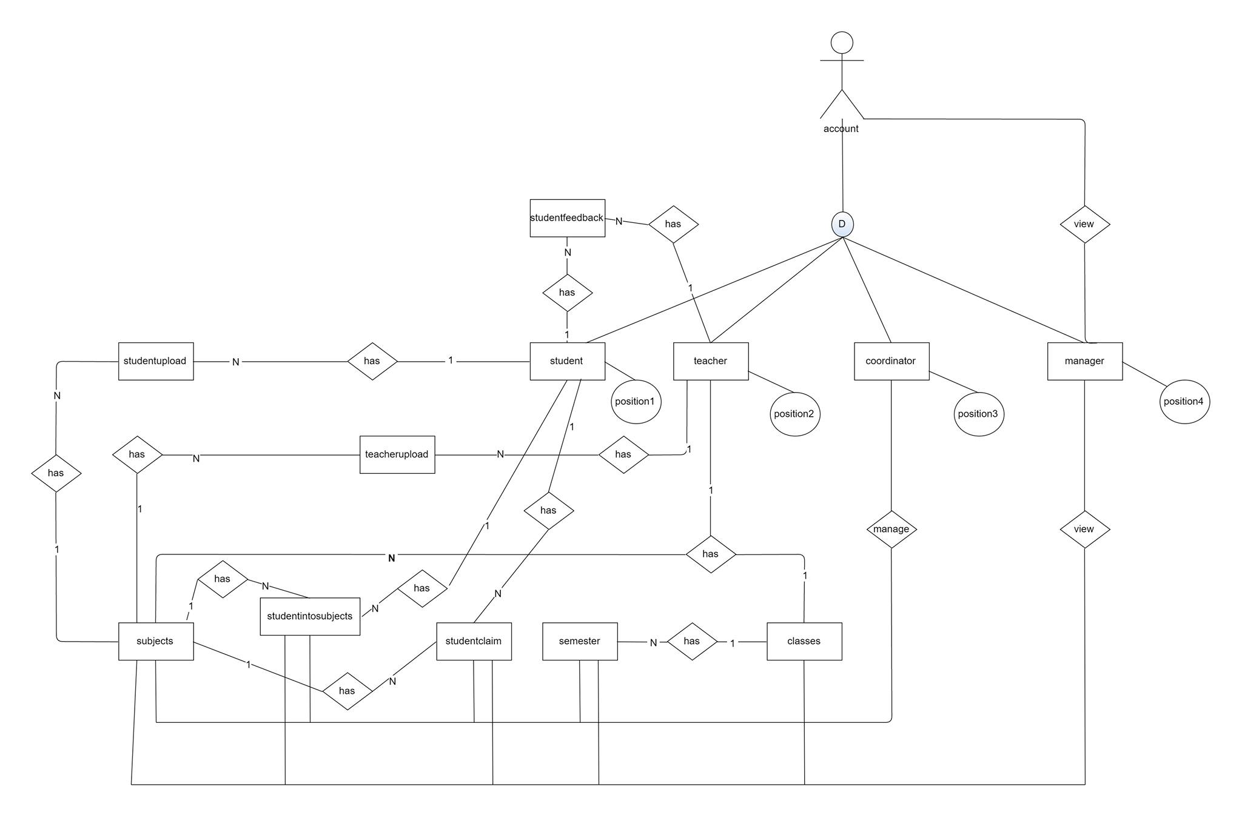
ER Diagrams design relational database

Slide 6
Role based system

Slide 7
Site design
REPONSIVE DESIGN
TESTING IN DIFFERENT SCREEN SOLUTION
USABILITY
ACCESSBILITY

Slide 9
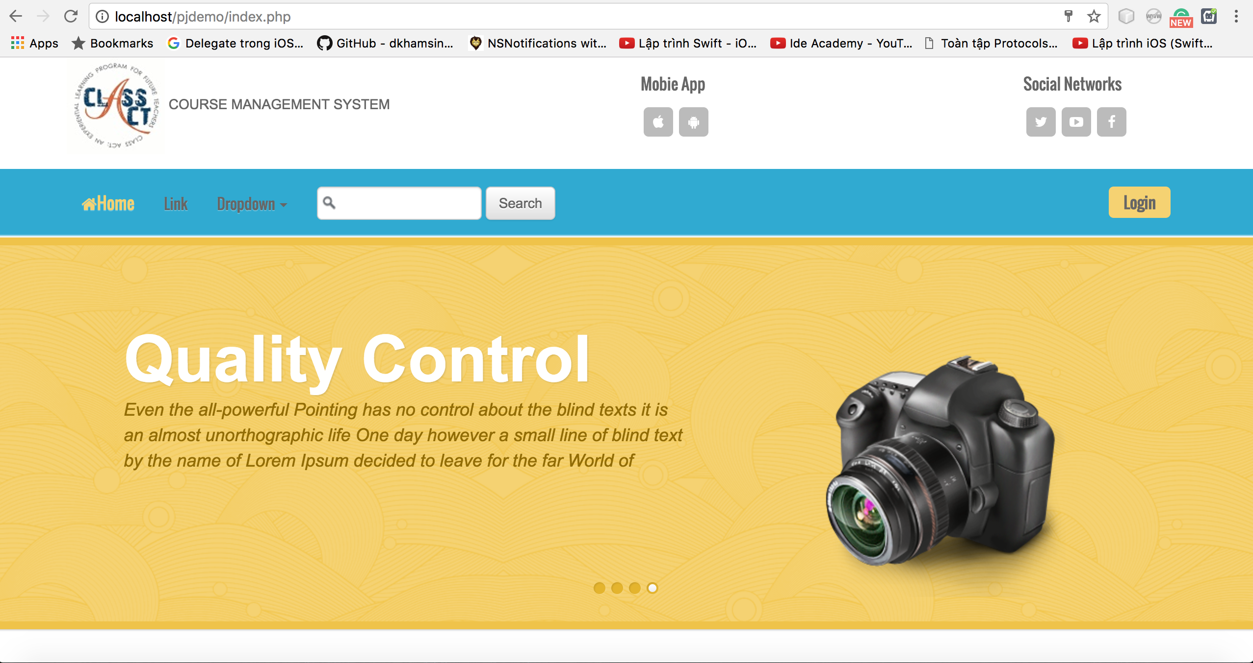
TESTING IN DIFFERENT SCREEN SOLUTION
Test on Chrome Browser

Slide 10
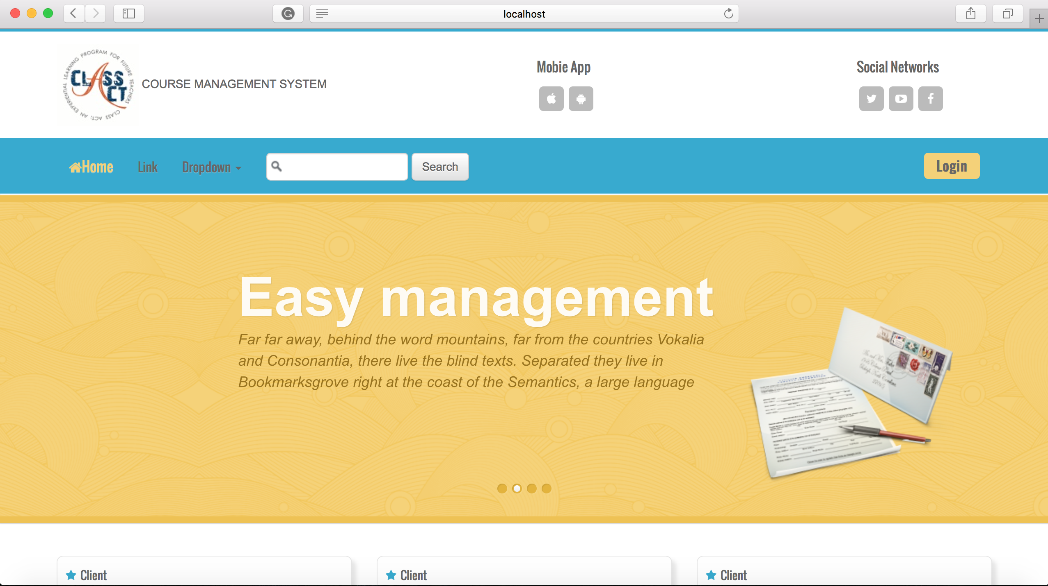
TESTING IN DIFFERENT SCREEN SOLUTION
Test on Safari Browser

Slide 11
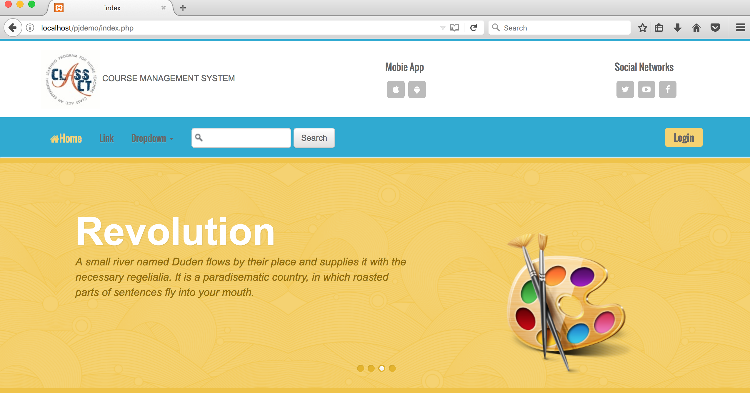
TESTING IN DIFFERENT SCREEN SOLUTION
Test on Firefox Browser

Slide 12
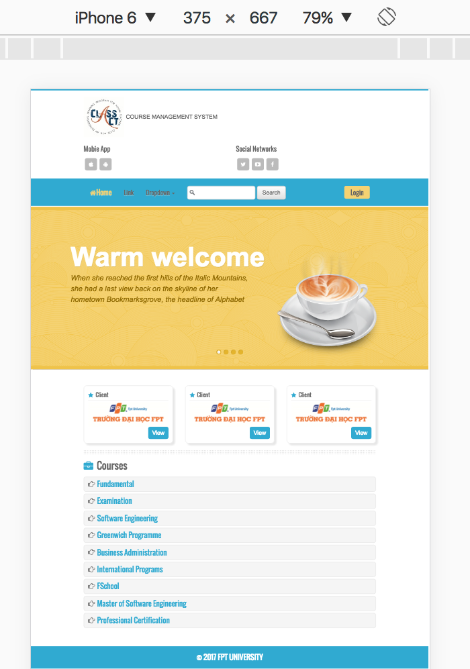
TESTING IN DIFFERENT SCREEN SOLUTION
Test on mobile iPhone 6

Slide 13
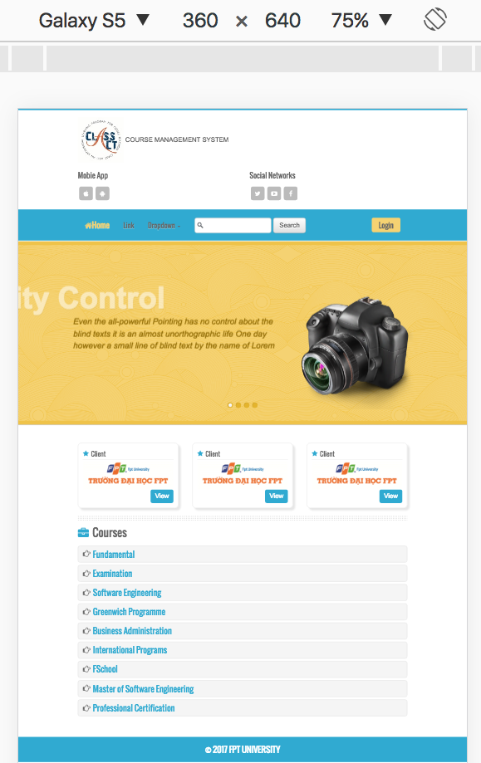
TESTING IN DIFFERENT SCREEN SOLUTION
Test on mobile Galaxy S5

Slide 14
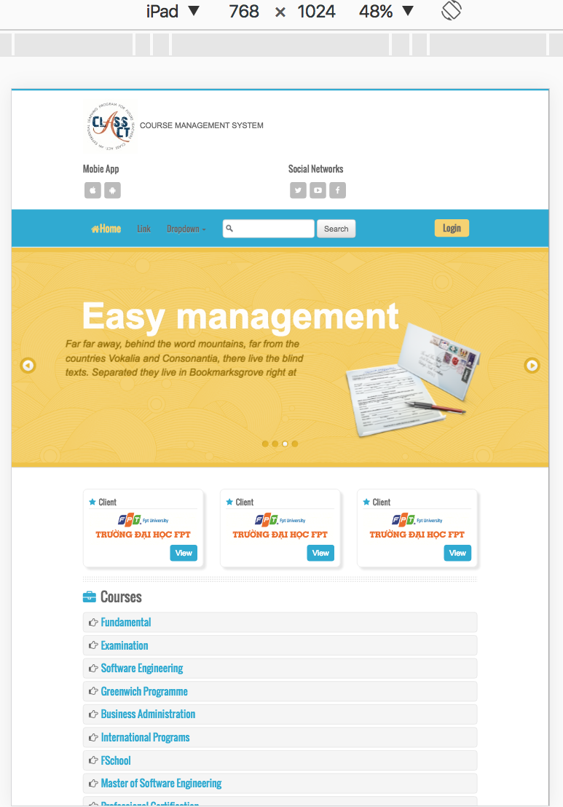
TESTING IN DIFFERENT SCREEN SOLUTION
Test on tablet iPad

Slide 15
Web usability
WEB USABILITY is the usability of website, check the website is easy to use, manipulation is friendly with the user

Slide 16

Web usability
MENTION ABOUT 5 SIDES OF WEB USABILITY
Learnability
User preference
Web Usability
Memorability
Speed
Efficiency

Slide 17
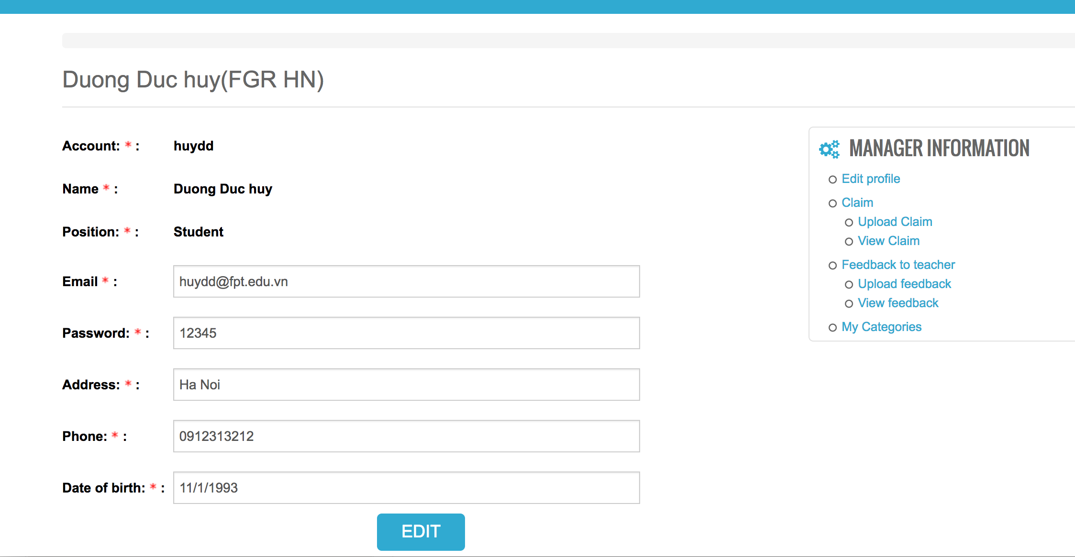
Web usability
Learnability – User has ability to learn to interact with the system
Clearly guide and logic, simple interact with the system

Slide 18
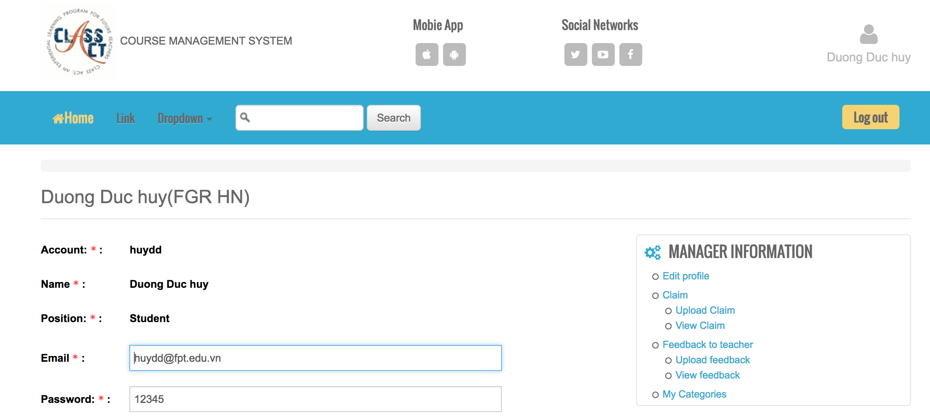
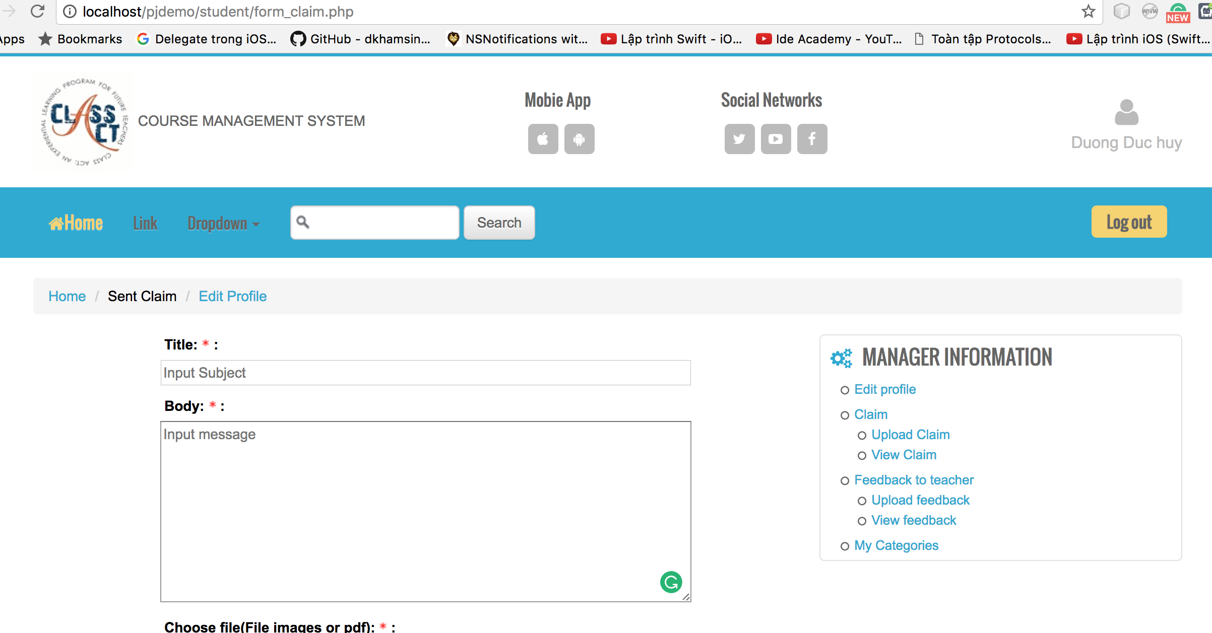
Web usability
Memorability
Maintain the consistent of system, user can use the memory to interact with system that used before, avoid user have to waste time to learn to interact to system again

Slide 19
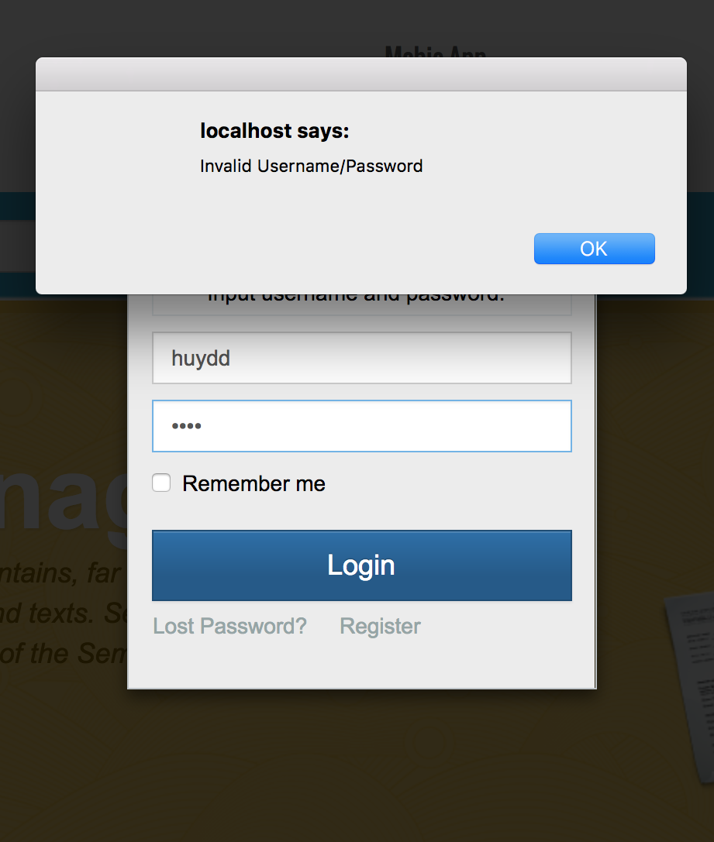
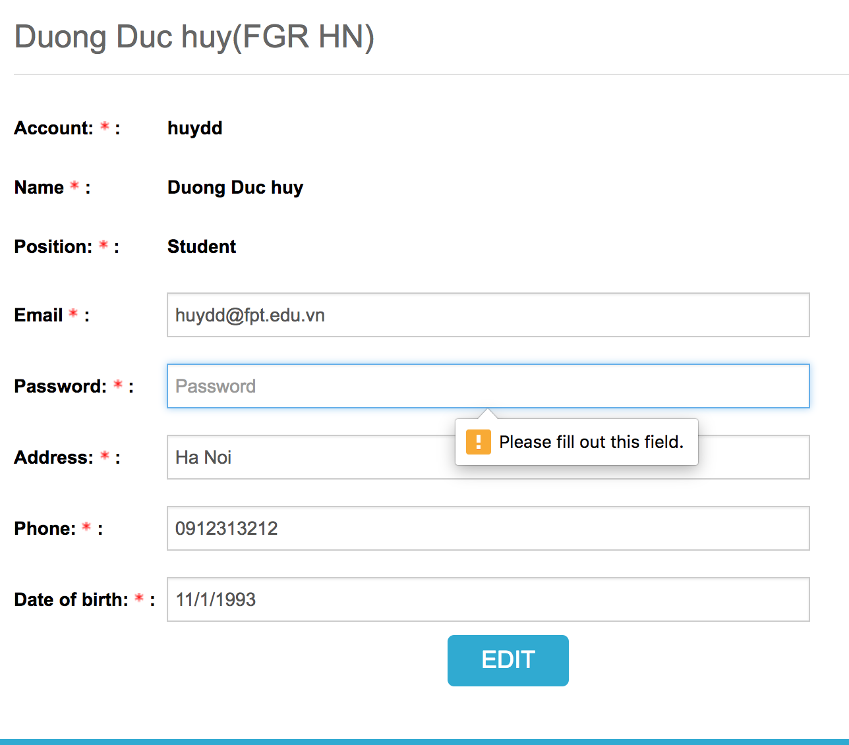
Web usability
Efficient
Prevent the user to make a bug, error when they do the wrong manipulation
Show alert to user.

Slide 20
Web usability
User preferences
Security the user information
Do the tasks that user wish to

Slide 21
Web accessibility
Web accessibility means that people with disabilities can use the Web
More specifically, Web accessibility means that people with disabilities can perceive, understand, navigate, and interact with the Web
My website still not solve the problem to develop accessibility

Slide 22
Functionality for each role in the website
The website has these main roles
Student
Teacher
Coordinator
Manager
. I will describe the functionality of each role base on User stories

Slide 23
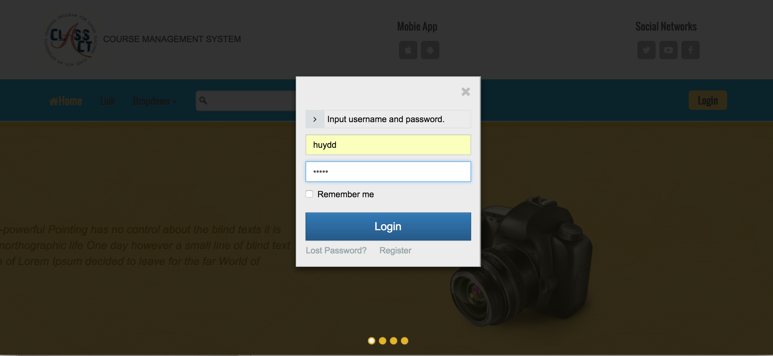
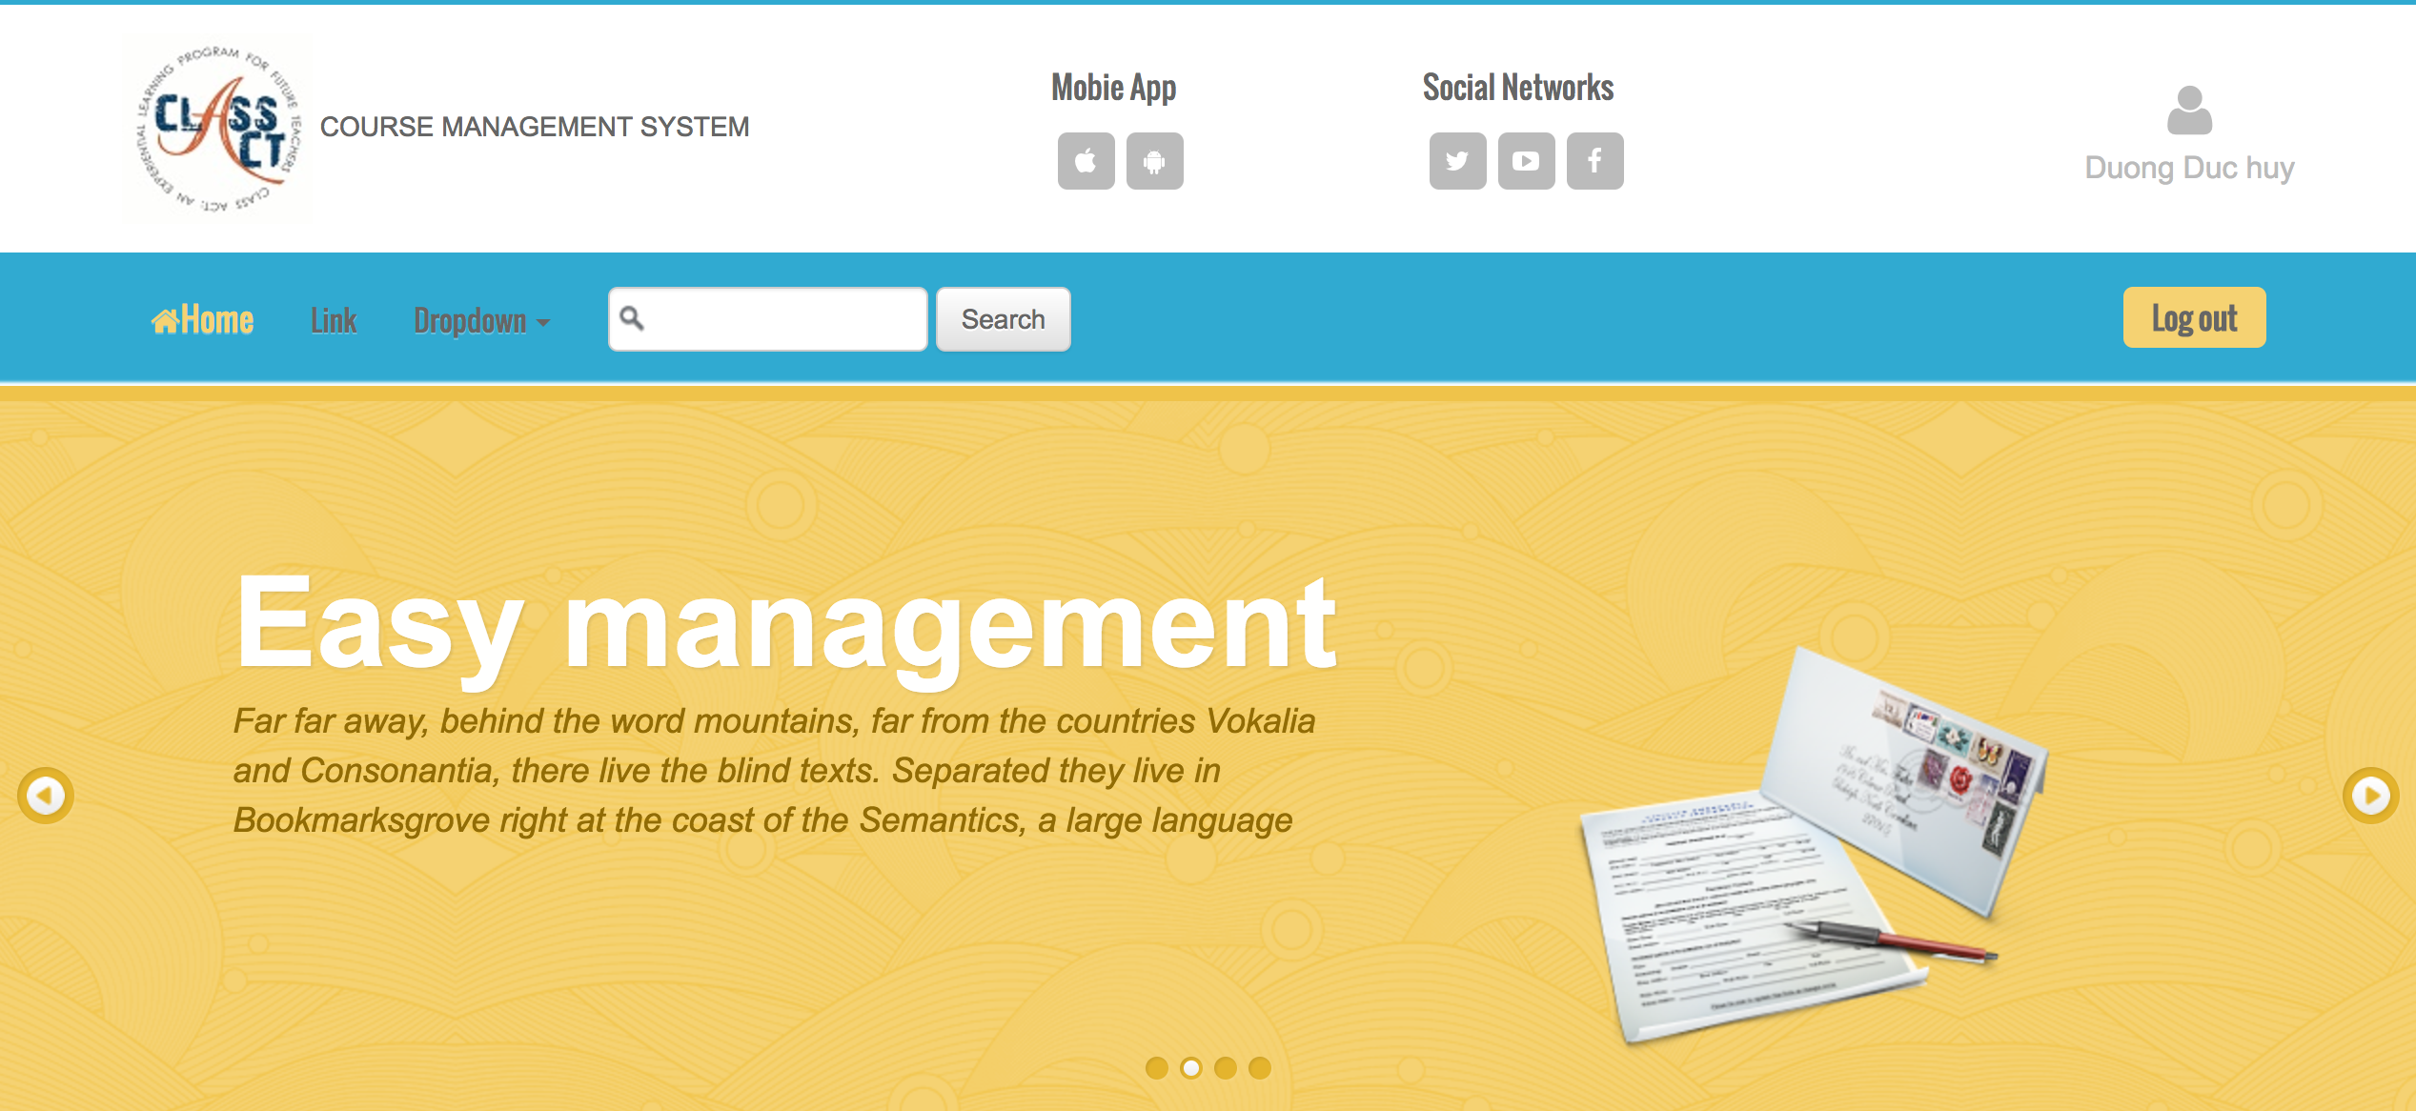
Functionality for each role in the website
As a Student.
Login/Logout to the System

Slide 24
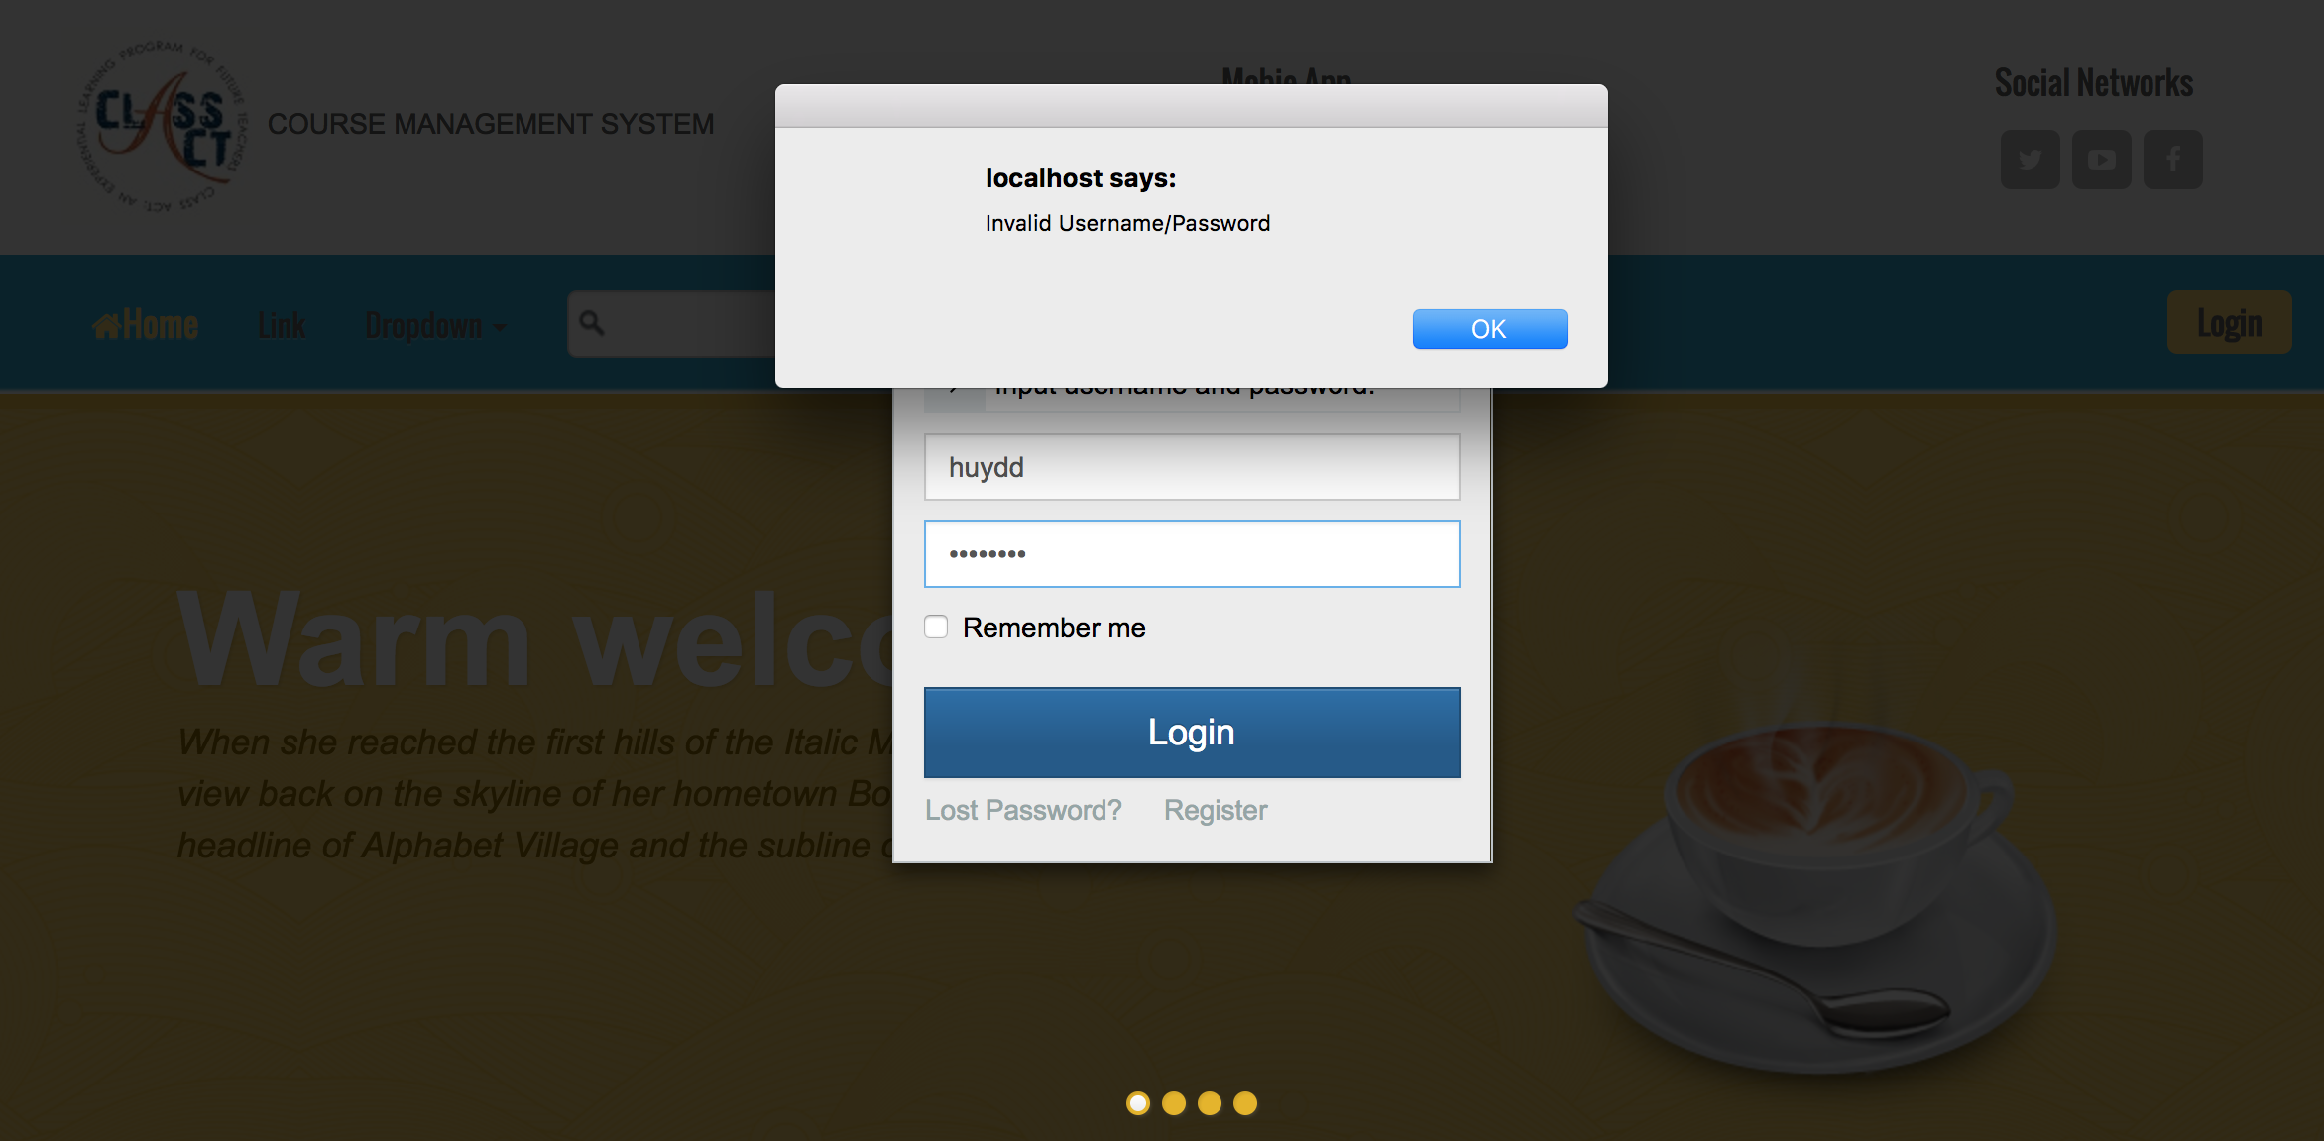
Functionality for each role in the website
As a Student
Login with validation data

Slide 25
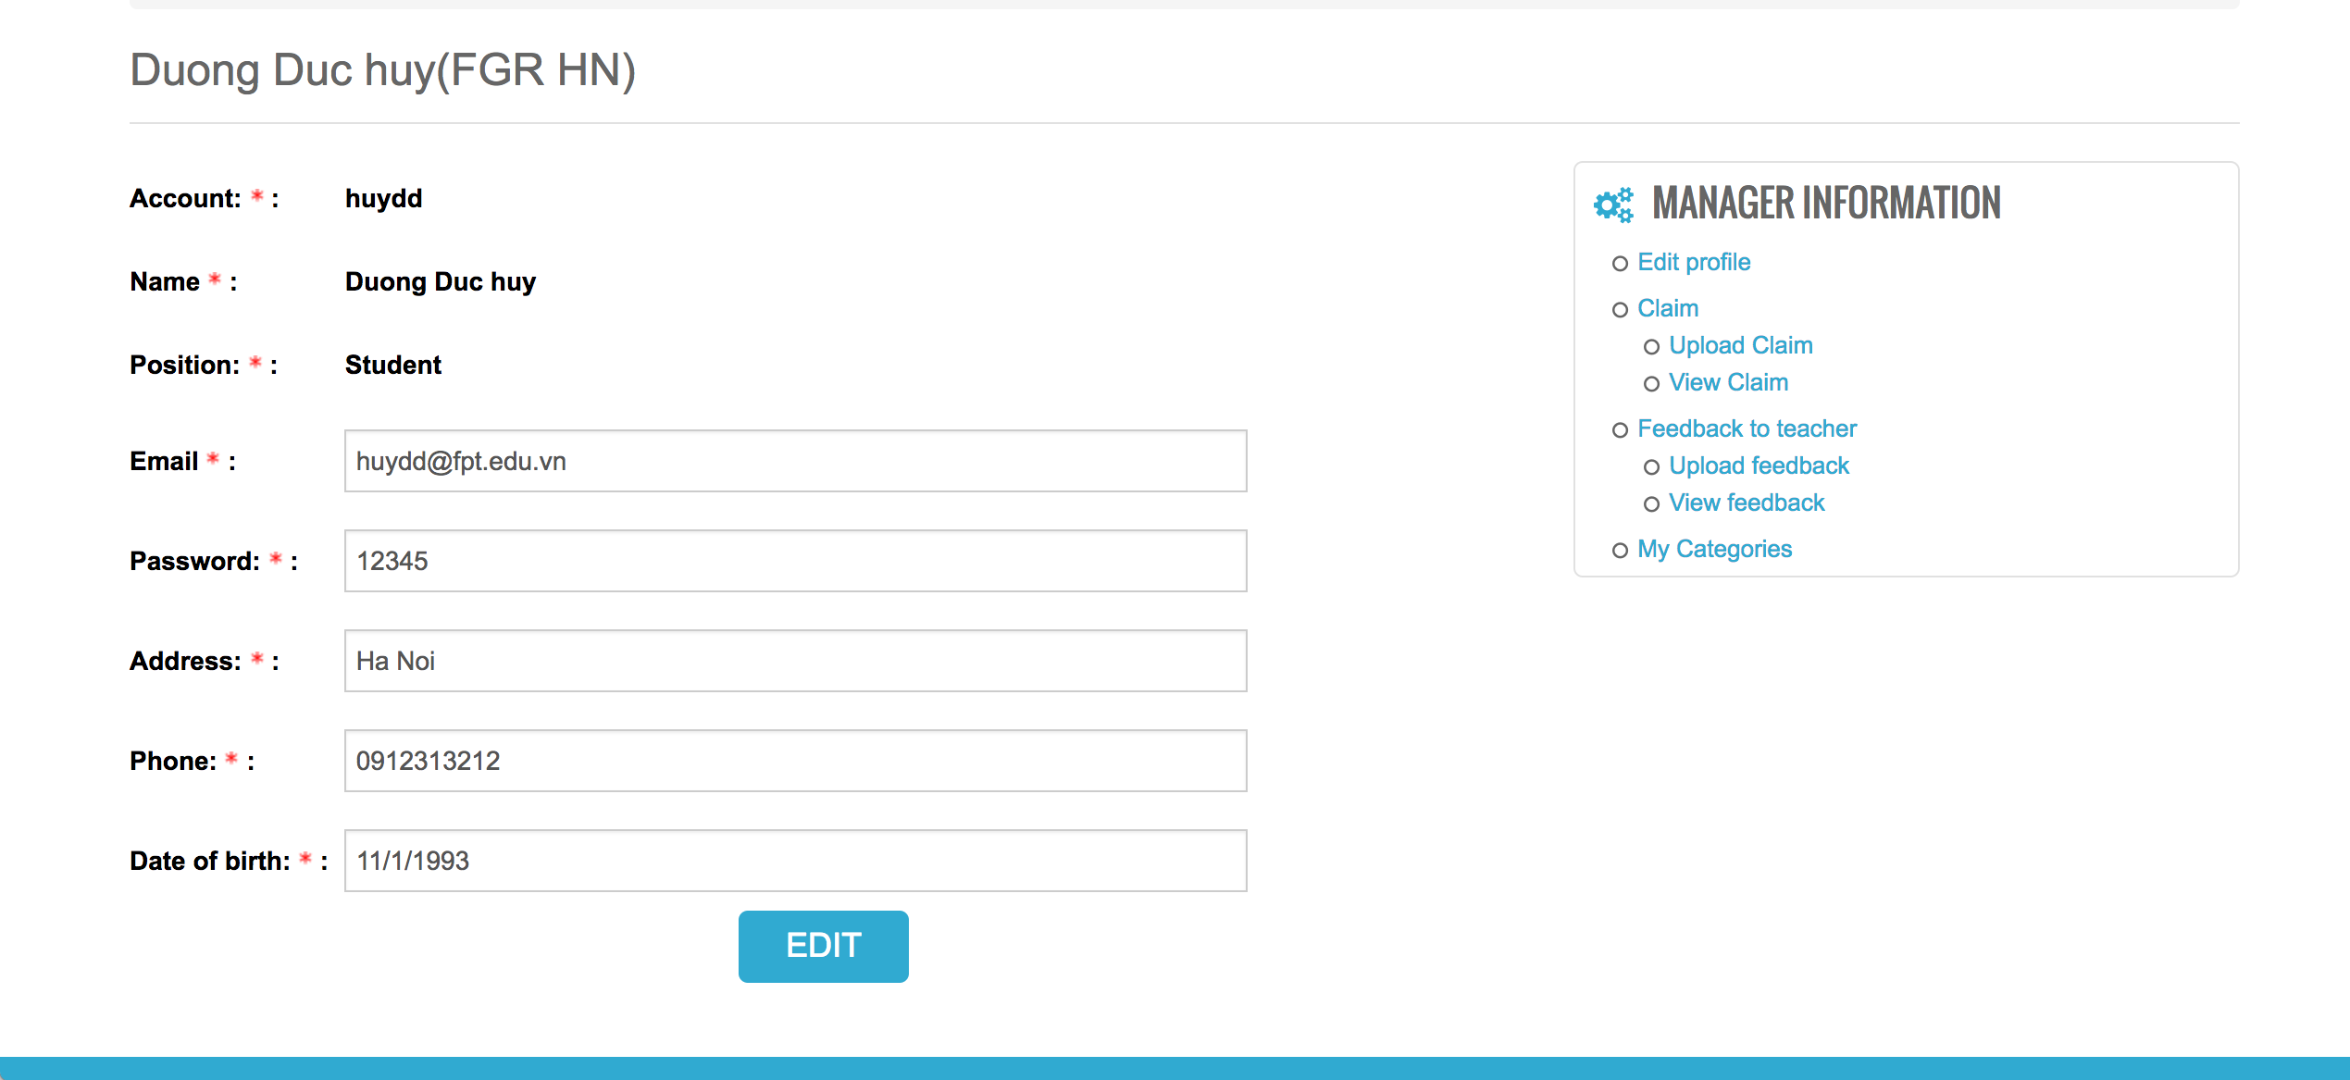
Functionality for each role in the website
As a Student
Edit the profile

Slide 26
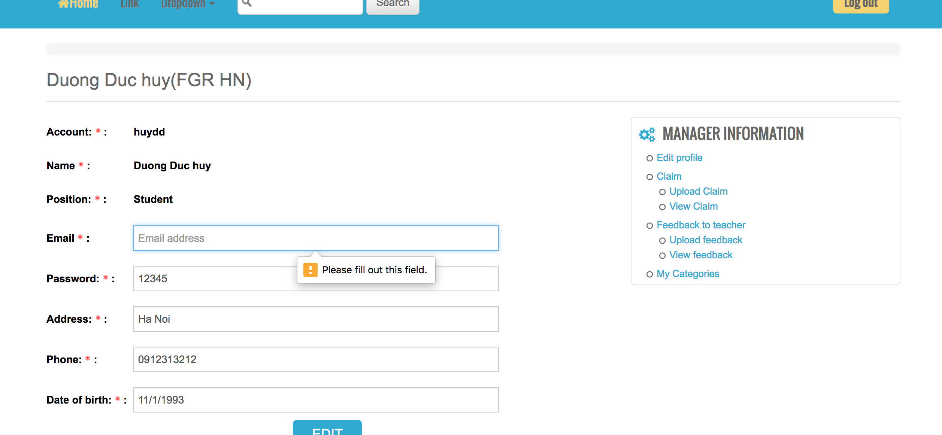
Functionality for each role in the website
As a Student
Edit the profile with validation data

Slide 27
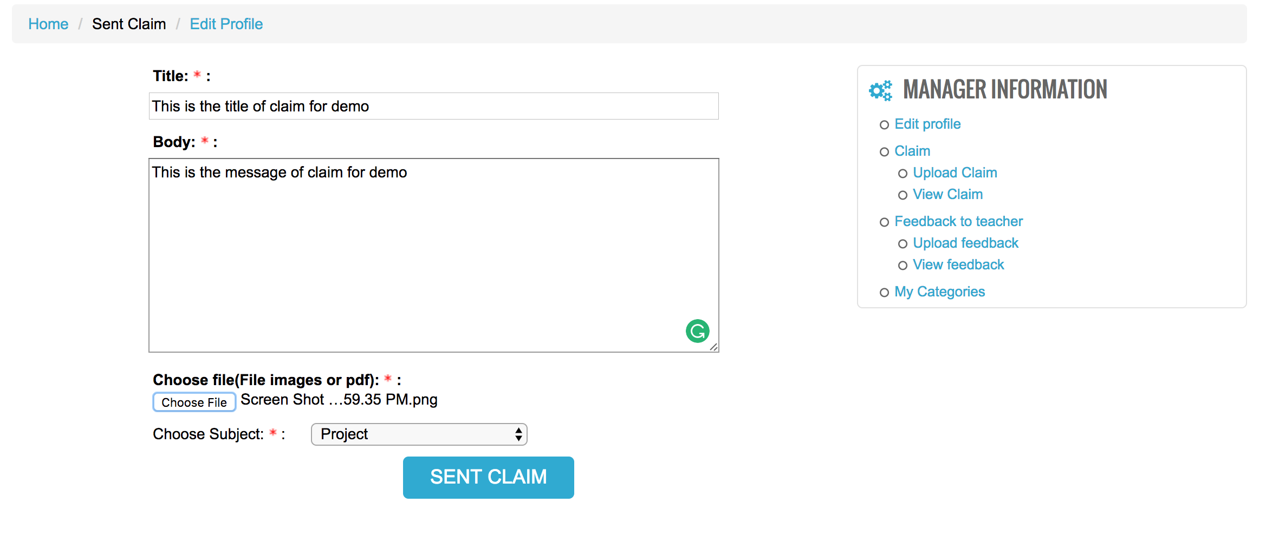
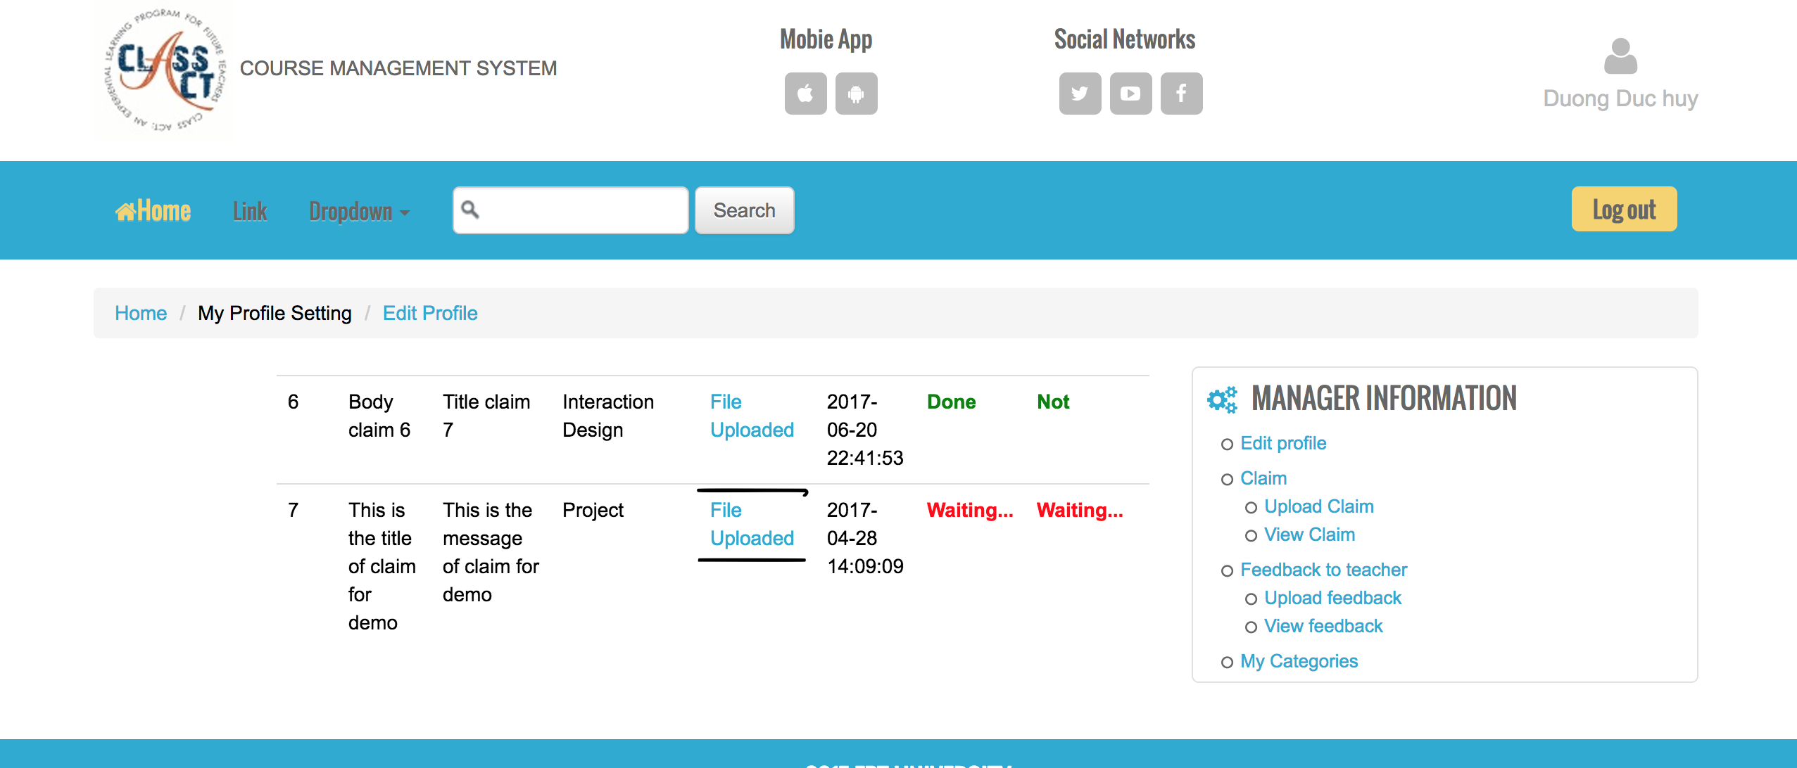
Functionality for each role in the website
As a student
Upload Claim with Evidence to Coordinator

Slide 28
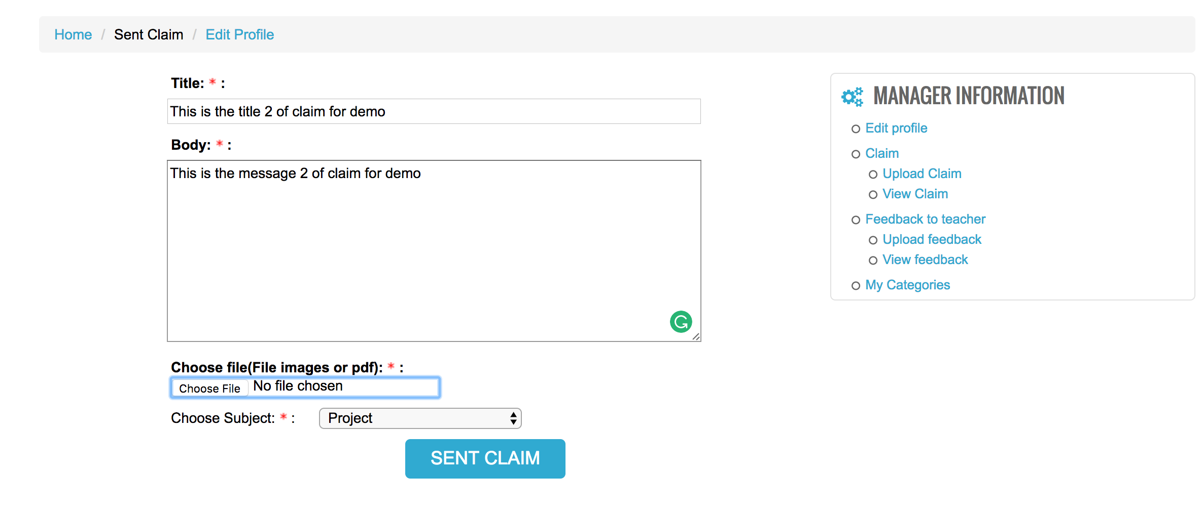
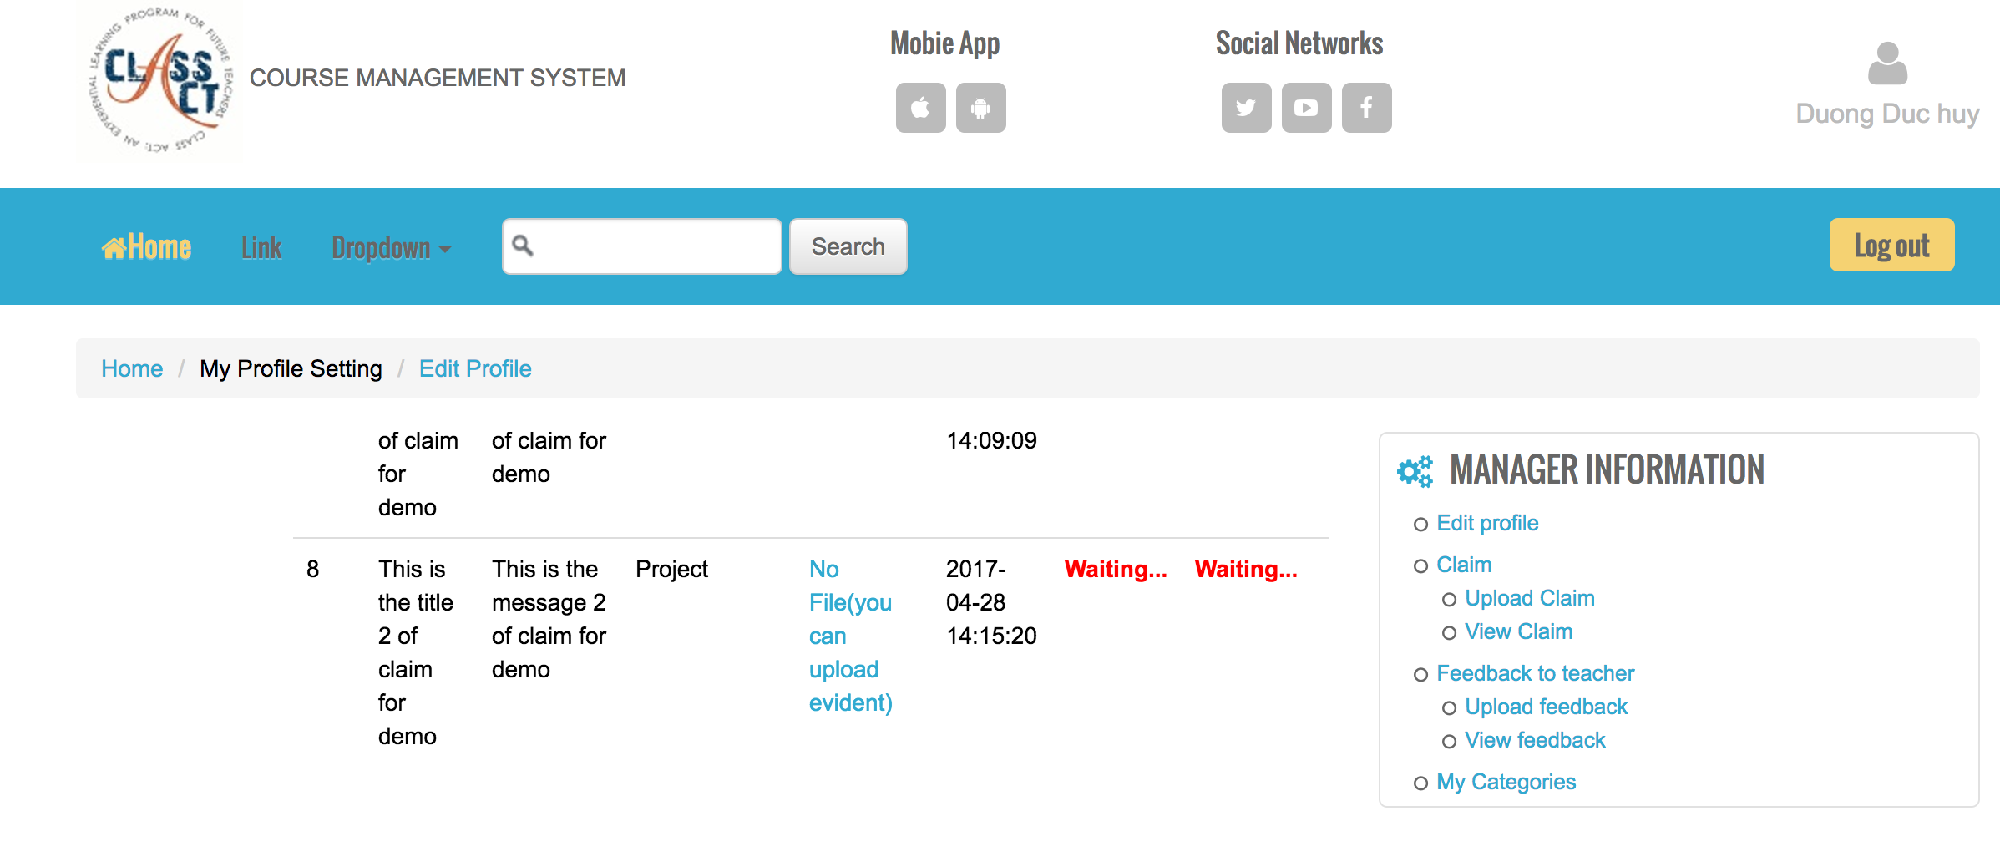
Functionality for each role in the website
As a student
Upload Claim without Evidence to Coordinator

Slide 29
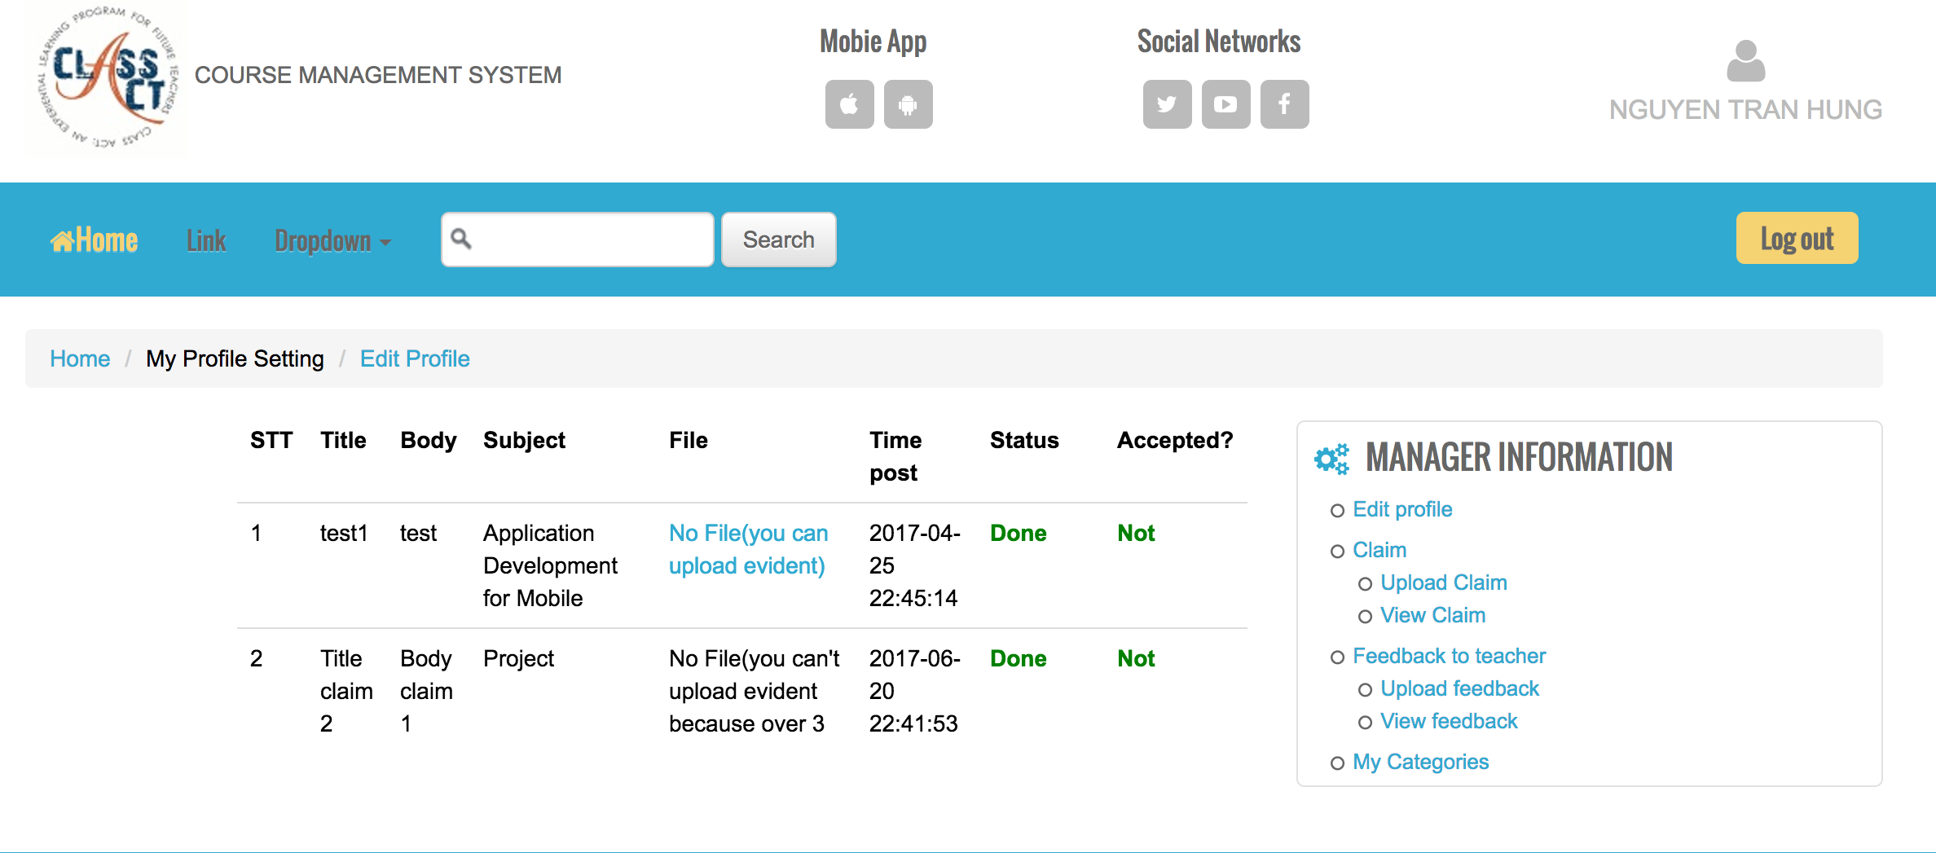
Functionality for each role in the website
As a student
I can upload Evidence later but no more than 3 day
U can not upload Evidence because the claim is sent over 3 days

Slide 30
Functionality for each role in the website
As a student
I can view the detail of claim , the status meaning the coordinator is answer or not, the accepted meaning the coordinator accept or not.
I can receive the answer letter through the email

Slide 31
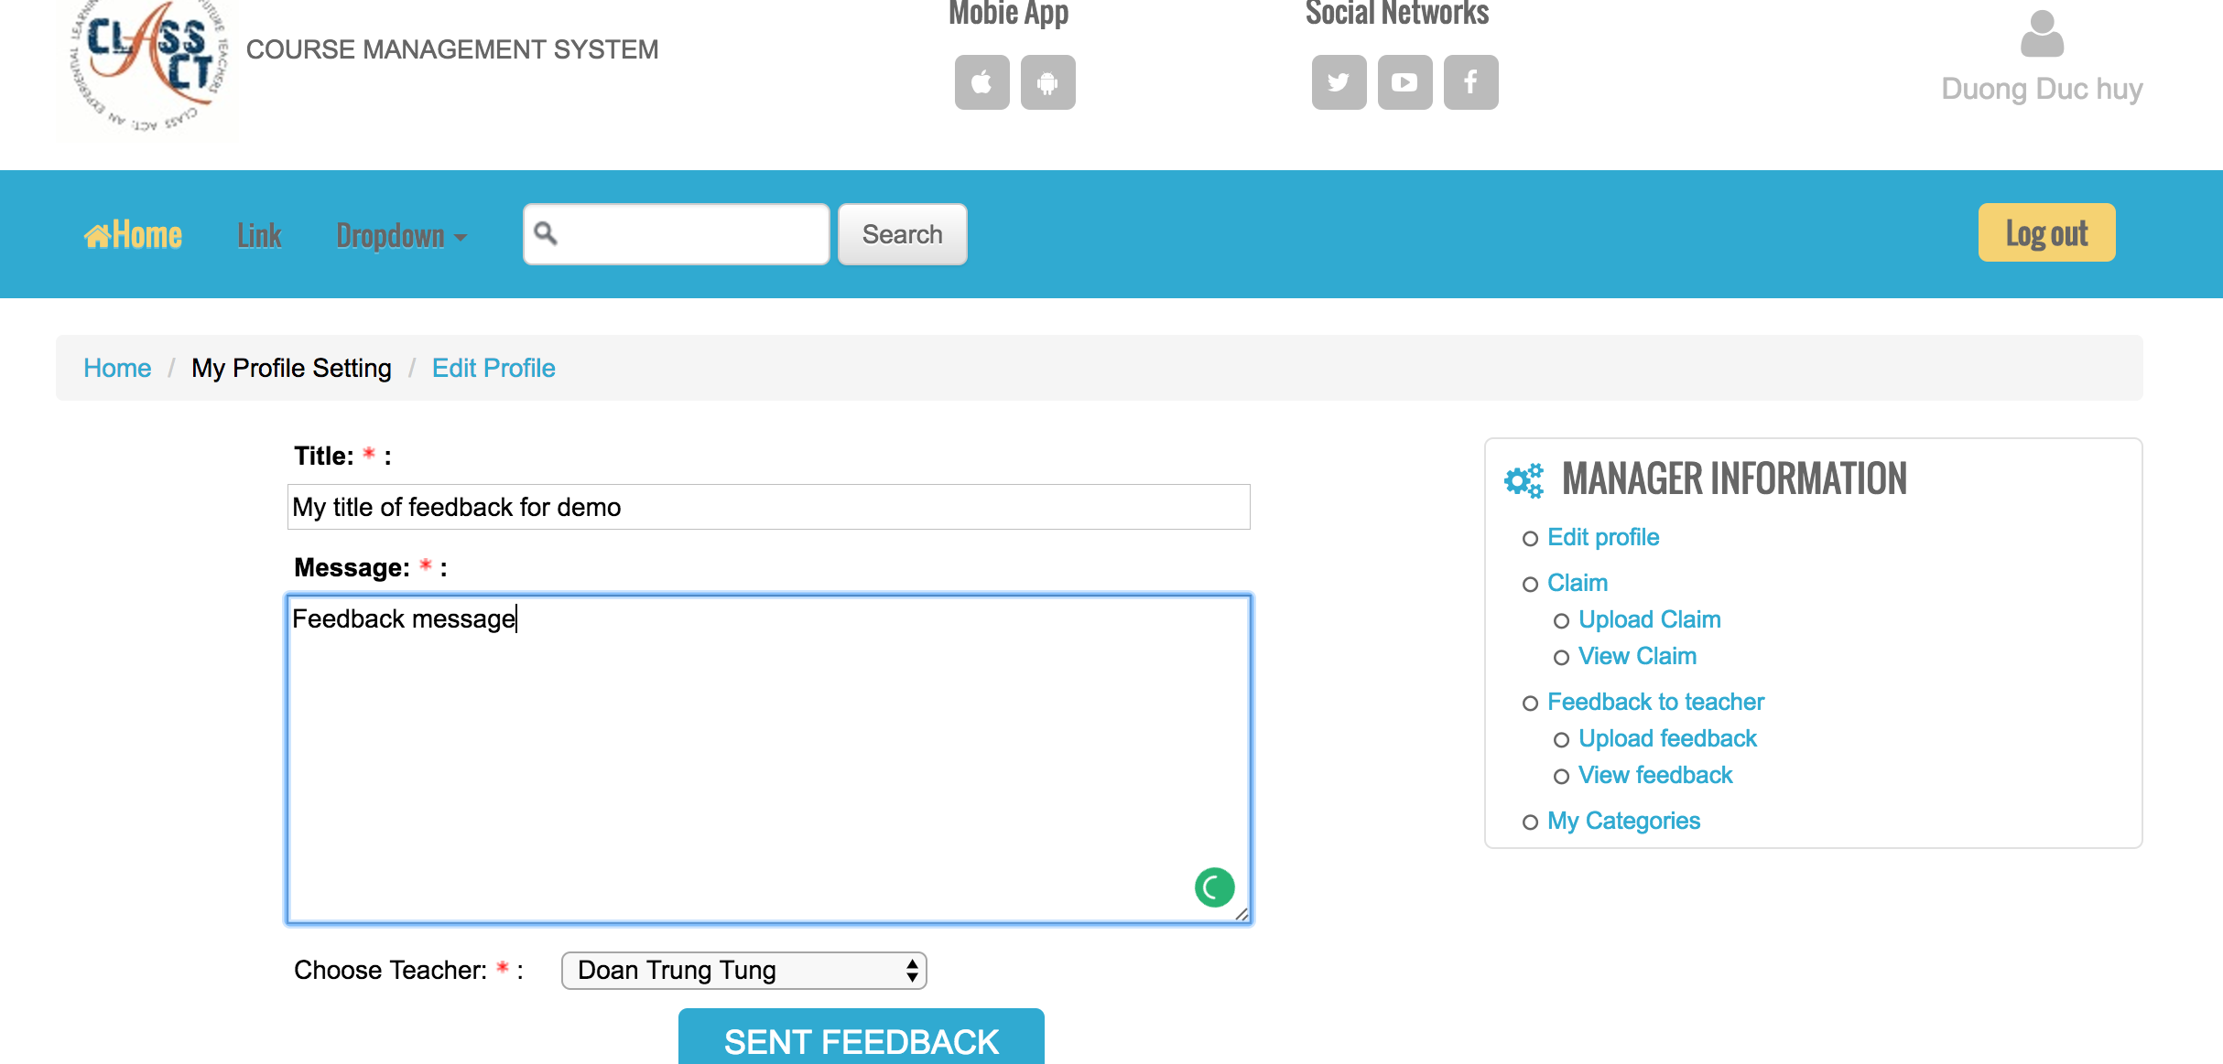
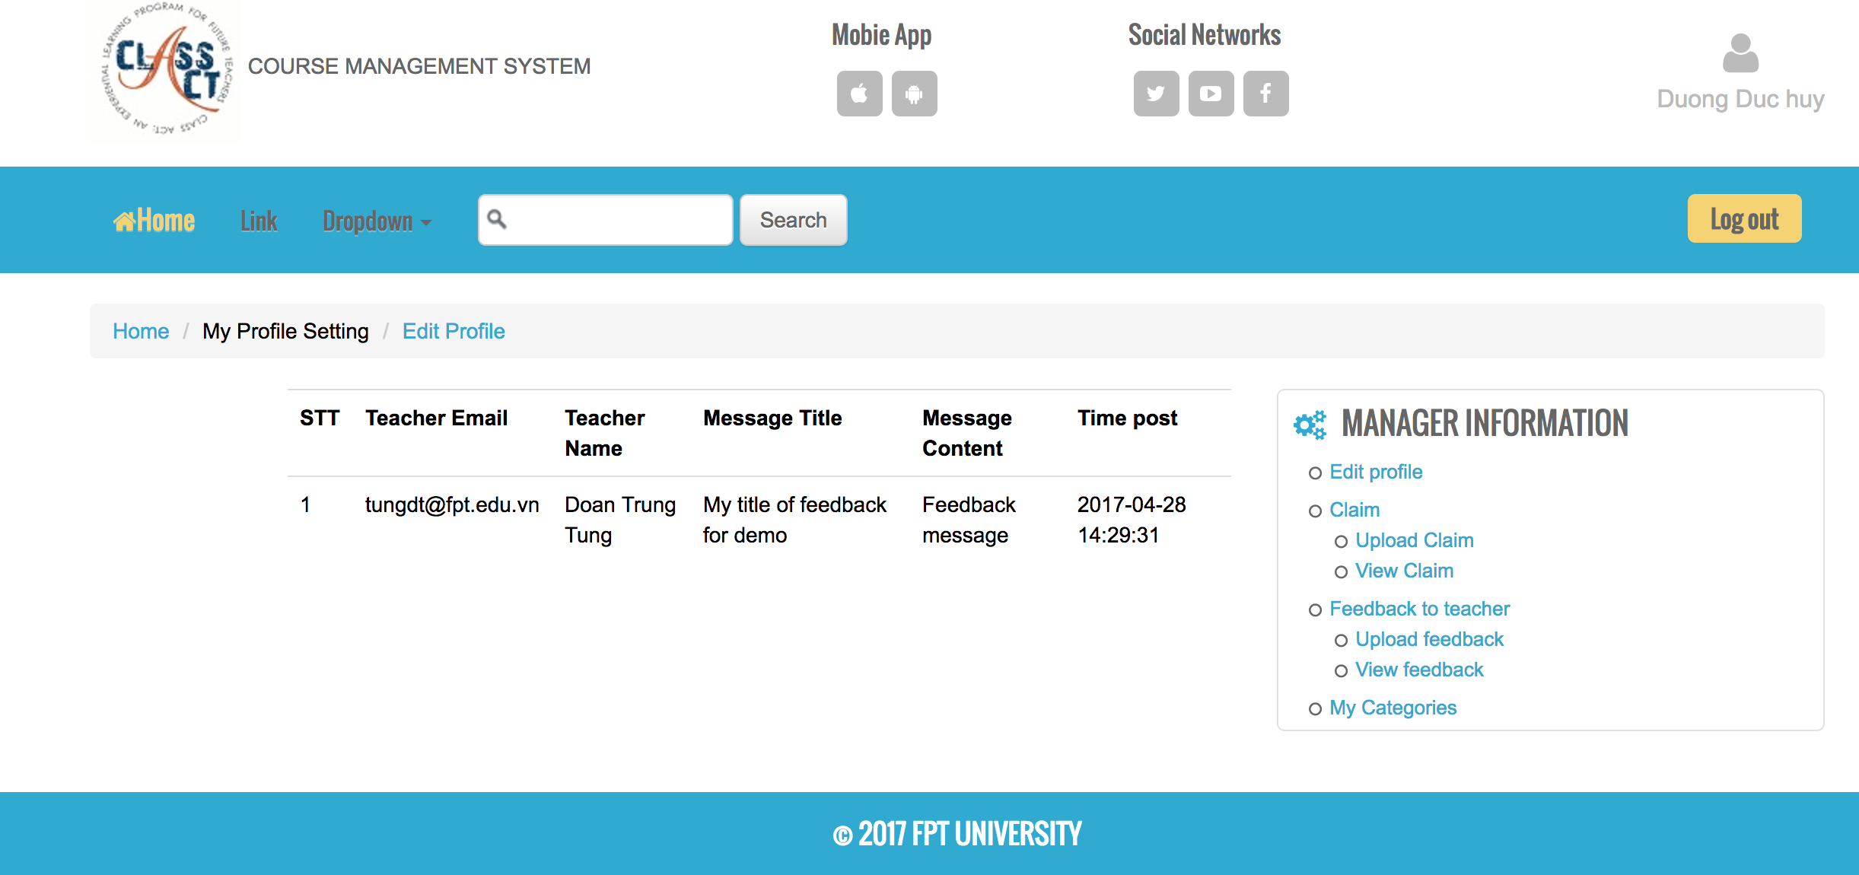
Functionality for each role in the website
As a Student
I can upload the feedback to the teacher and view my feedback that I have uploaded before

Slide 32
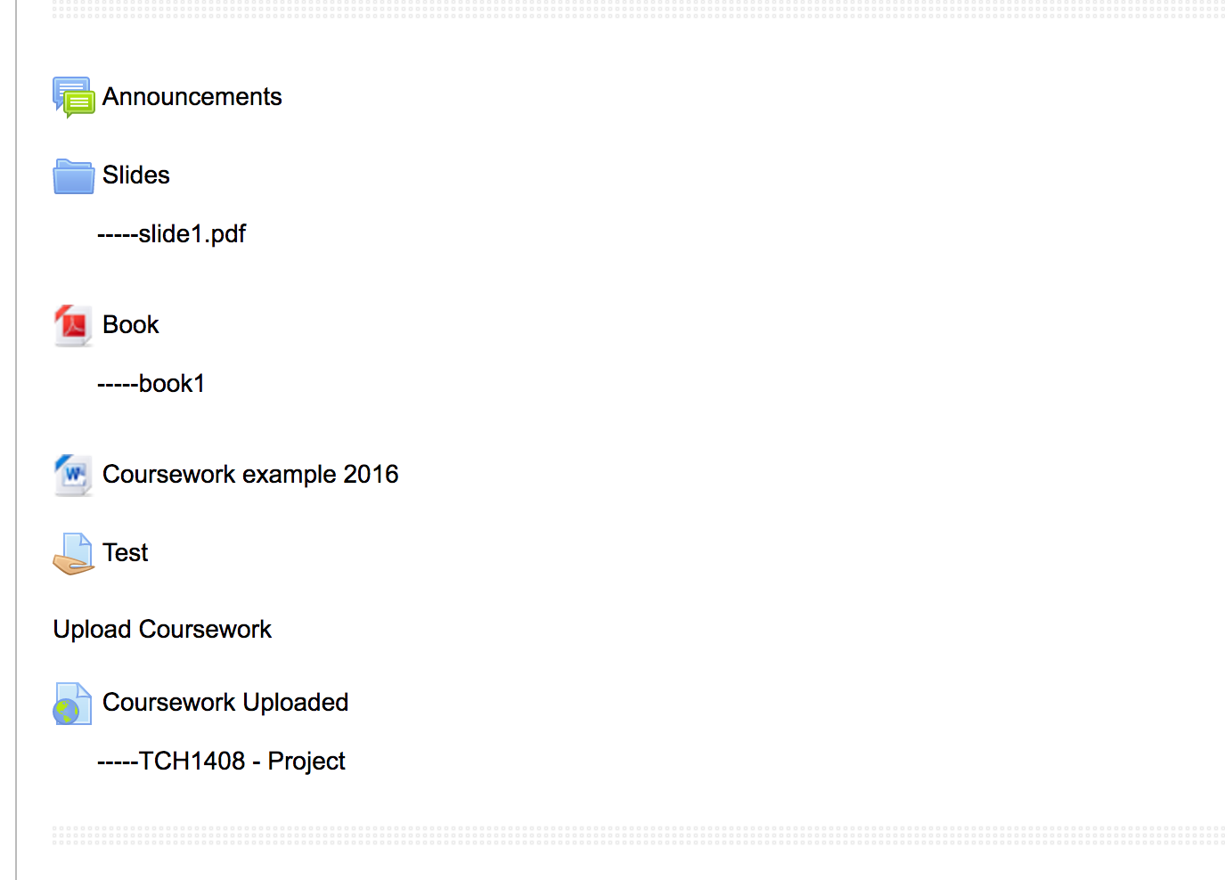
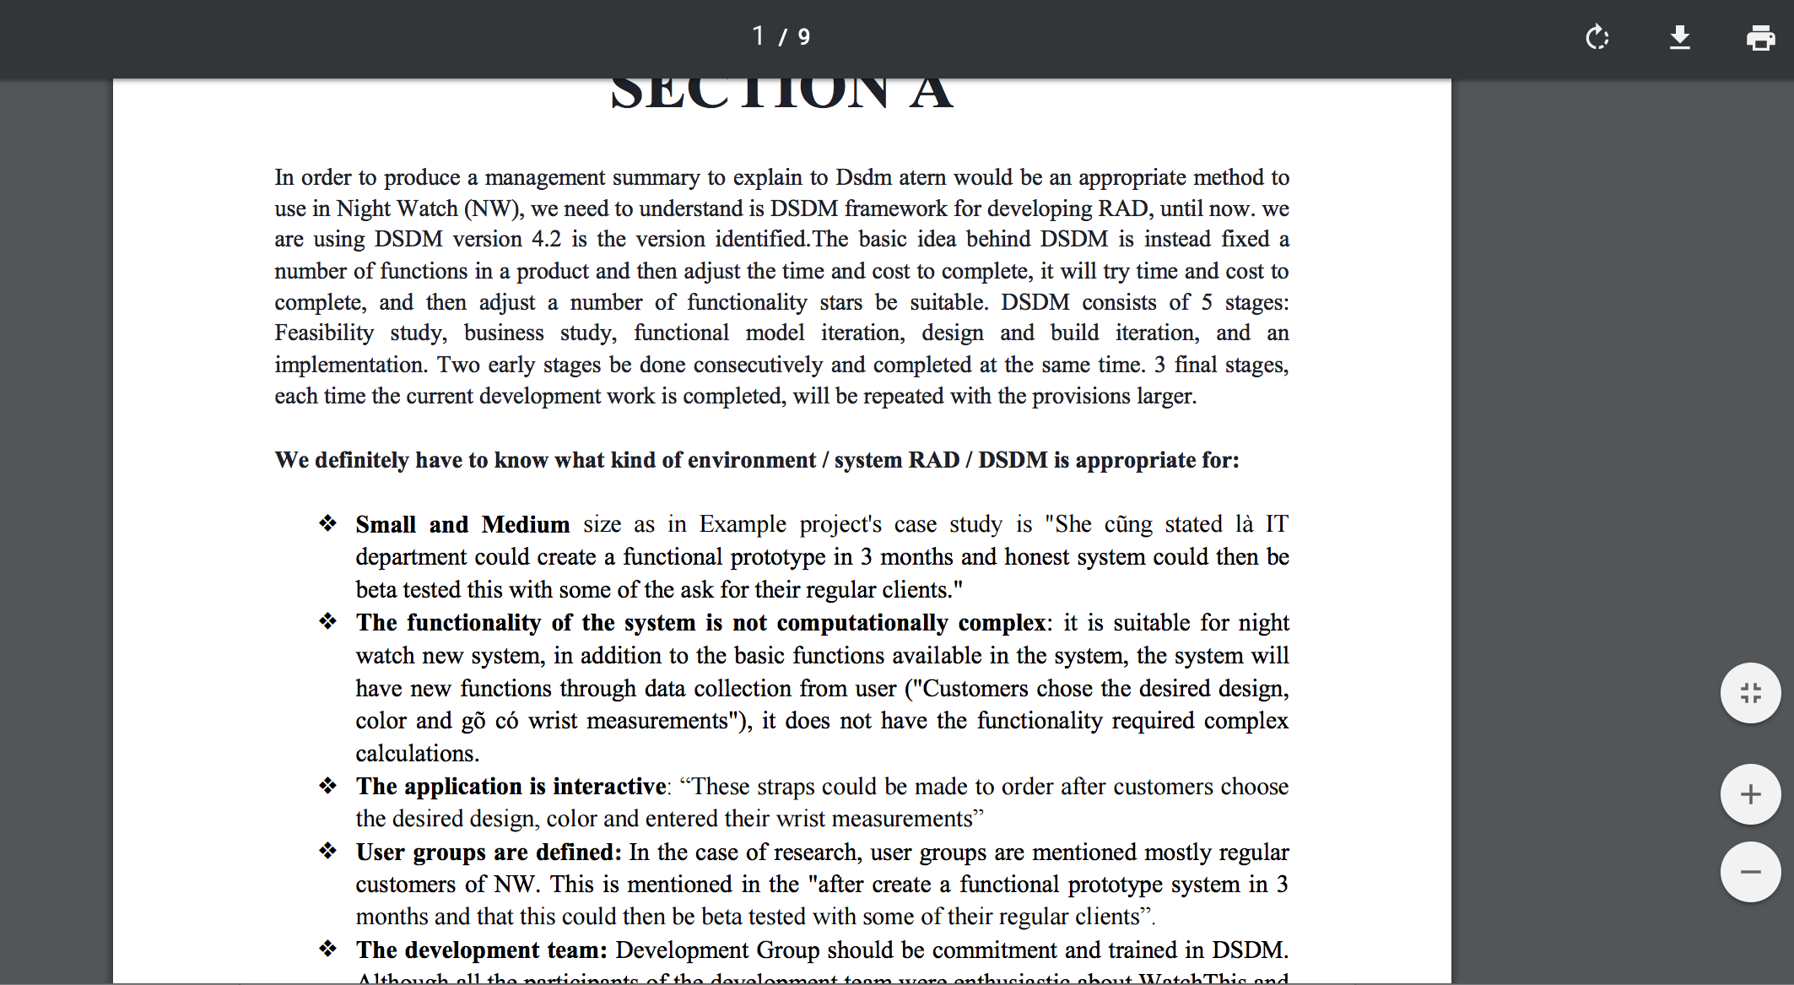
Functionality for each role in the website
As a student
I can view and download all of the document

Slide 33
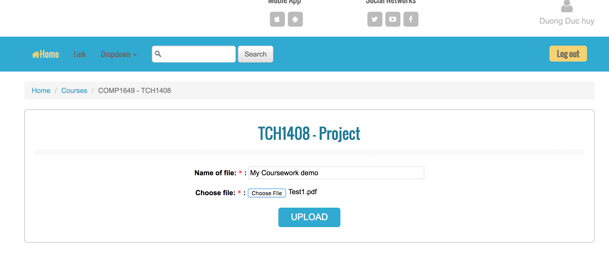
Functionality for each role in the website
As a student
I can upload the coursework

Slide 34
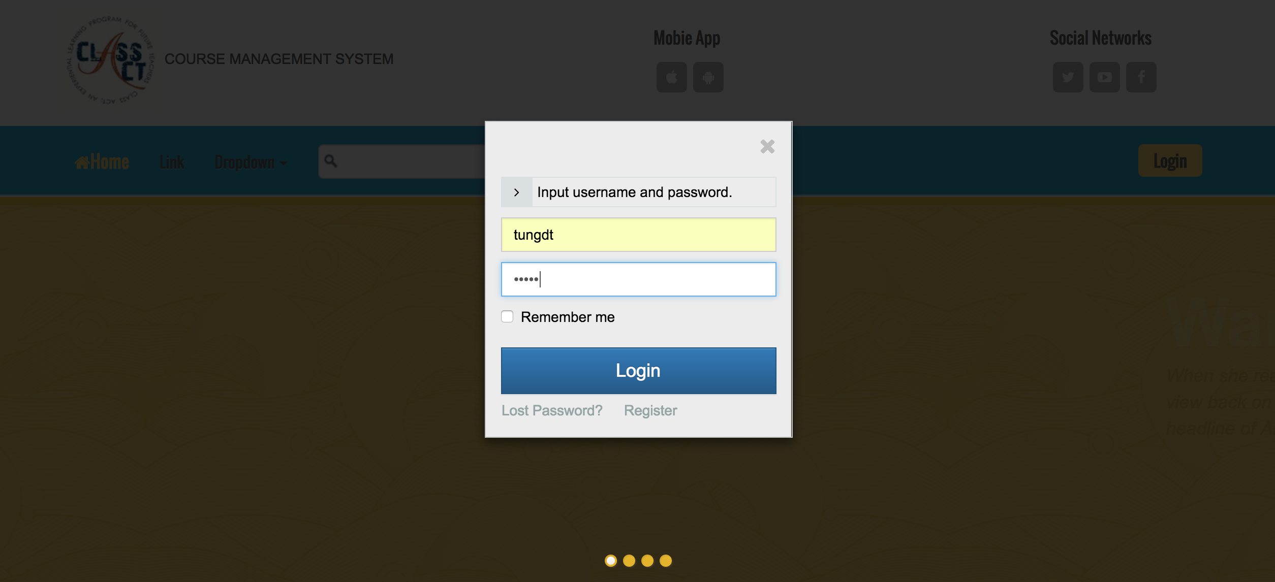
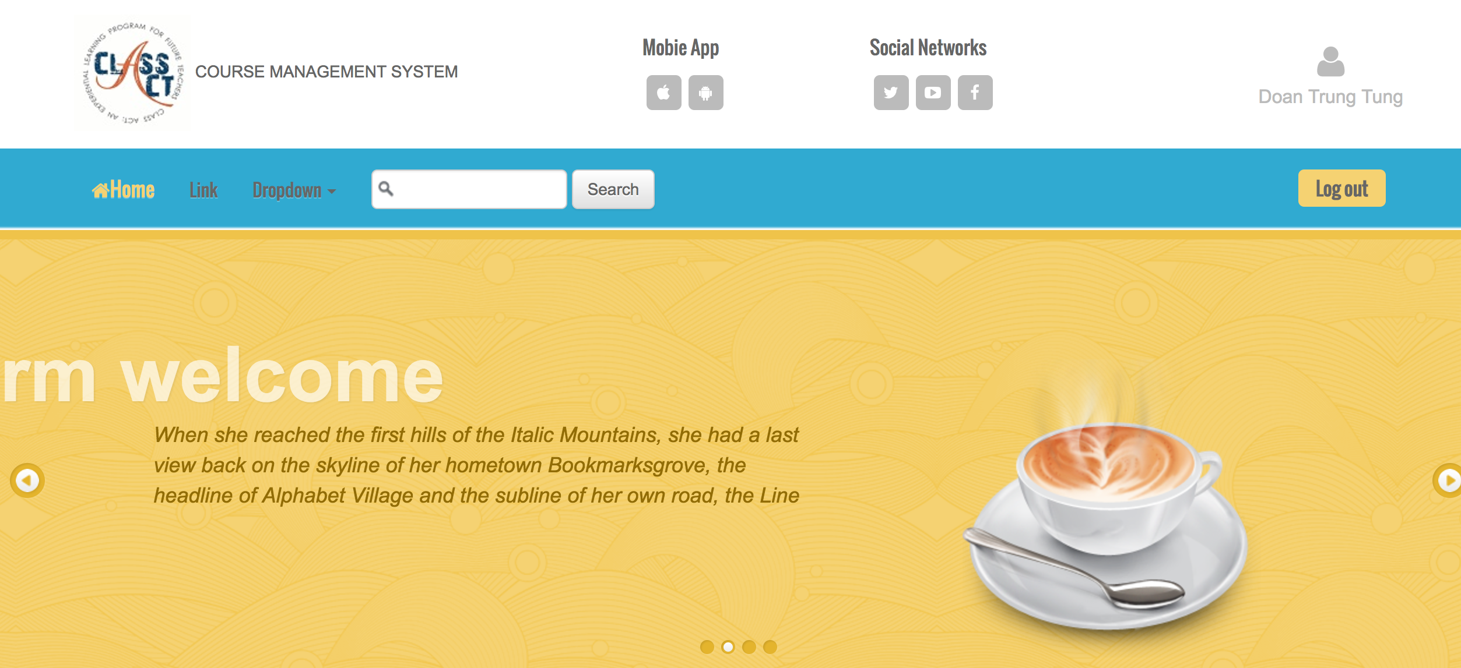
Functionality for each role in the website
As A Teacher
I can login/logout to system

Slide 35
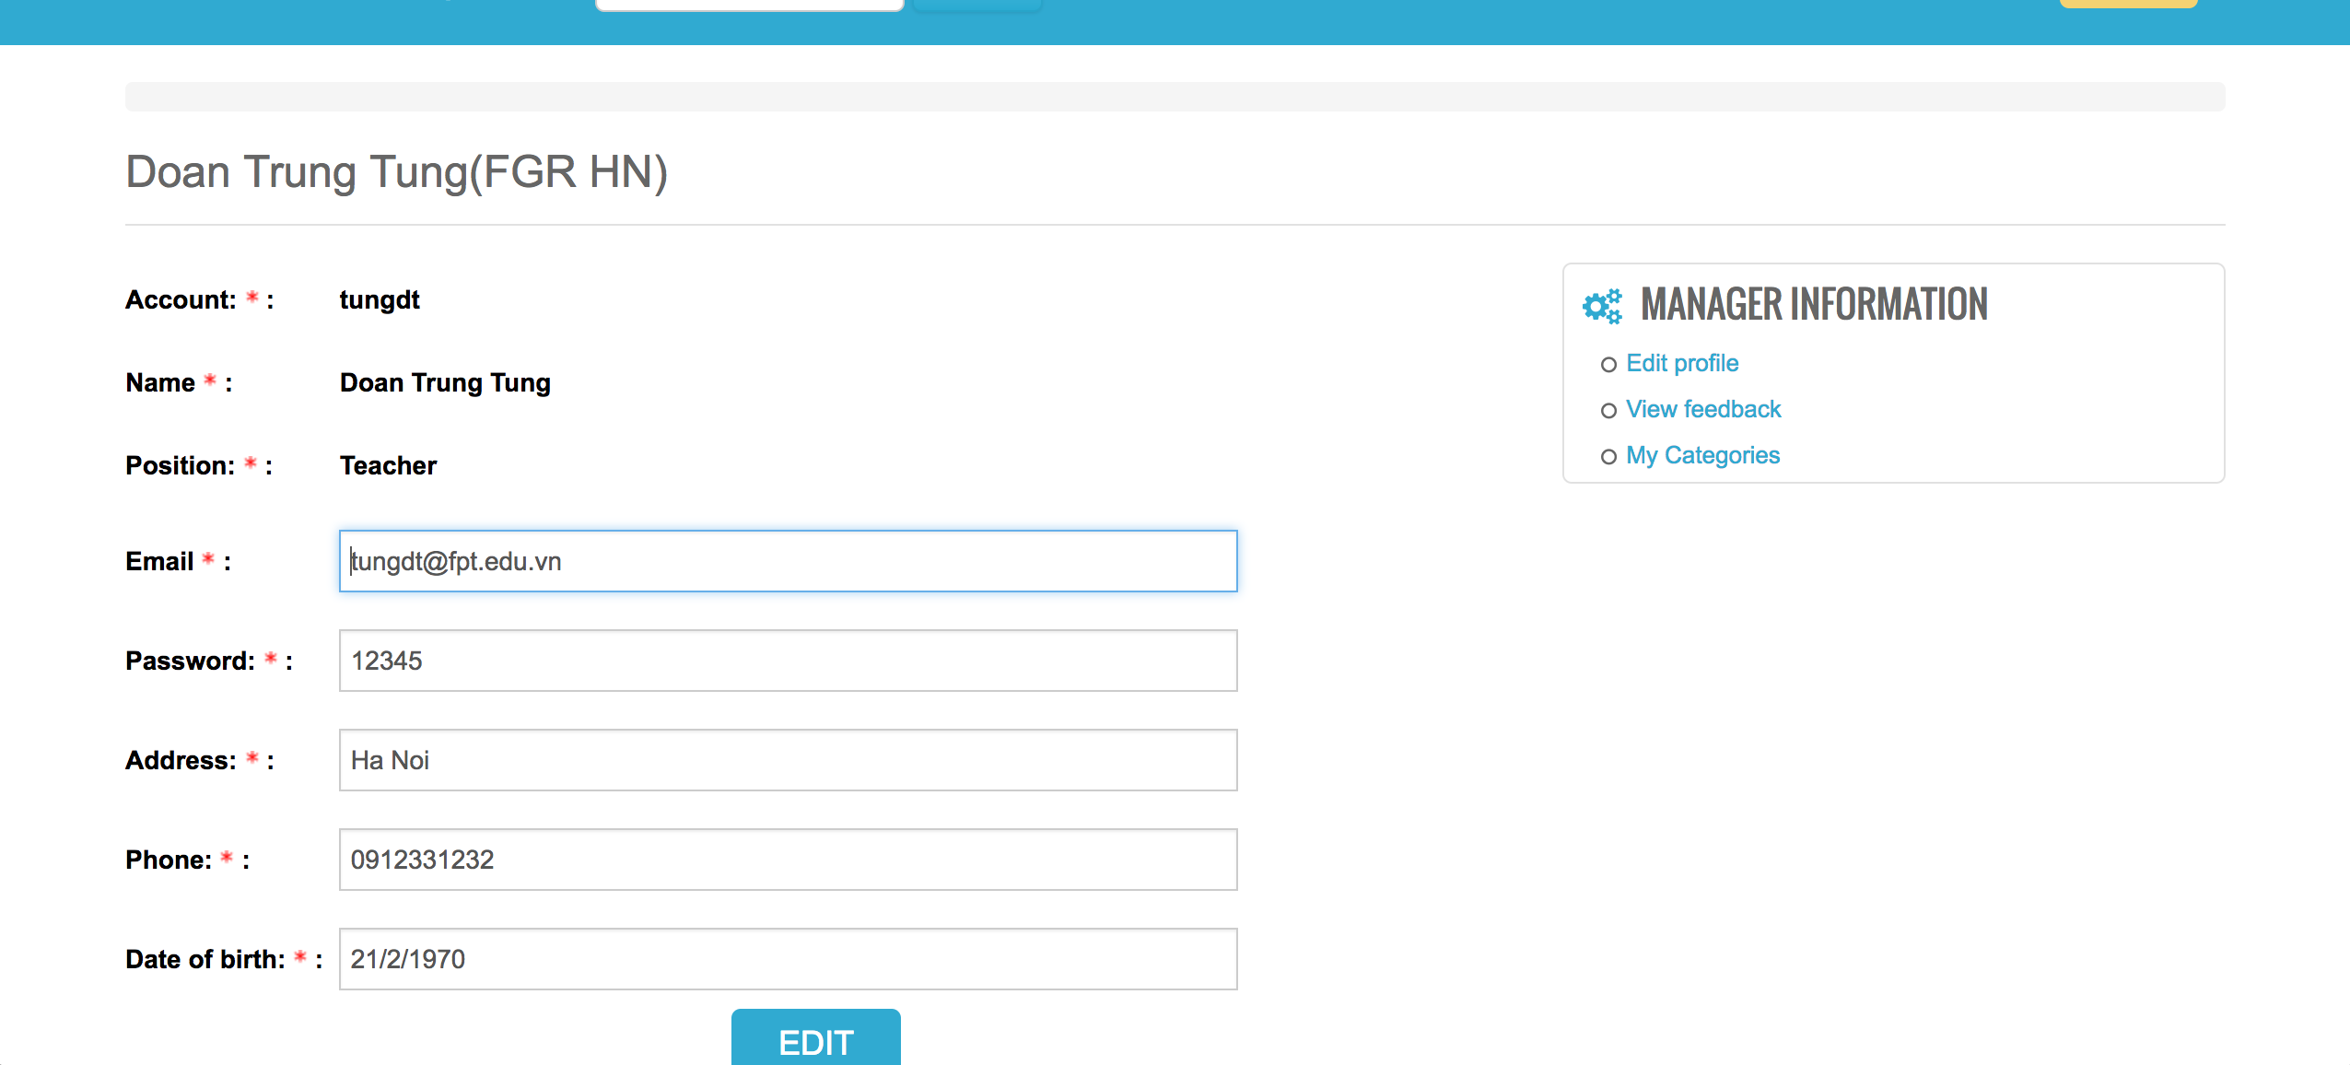
Functionality for each role in the website
As a Teacher
I can edit the profile

Slide 36
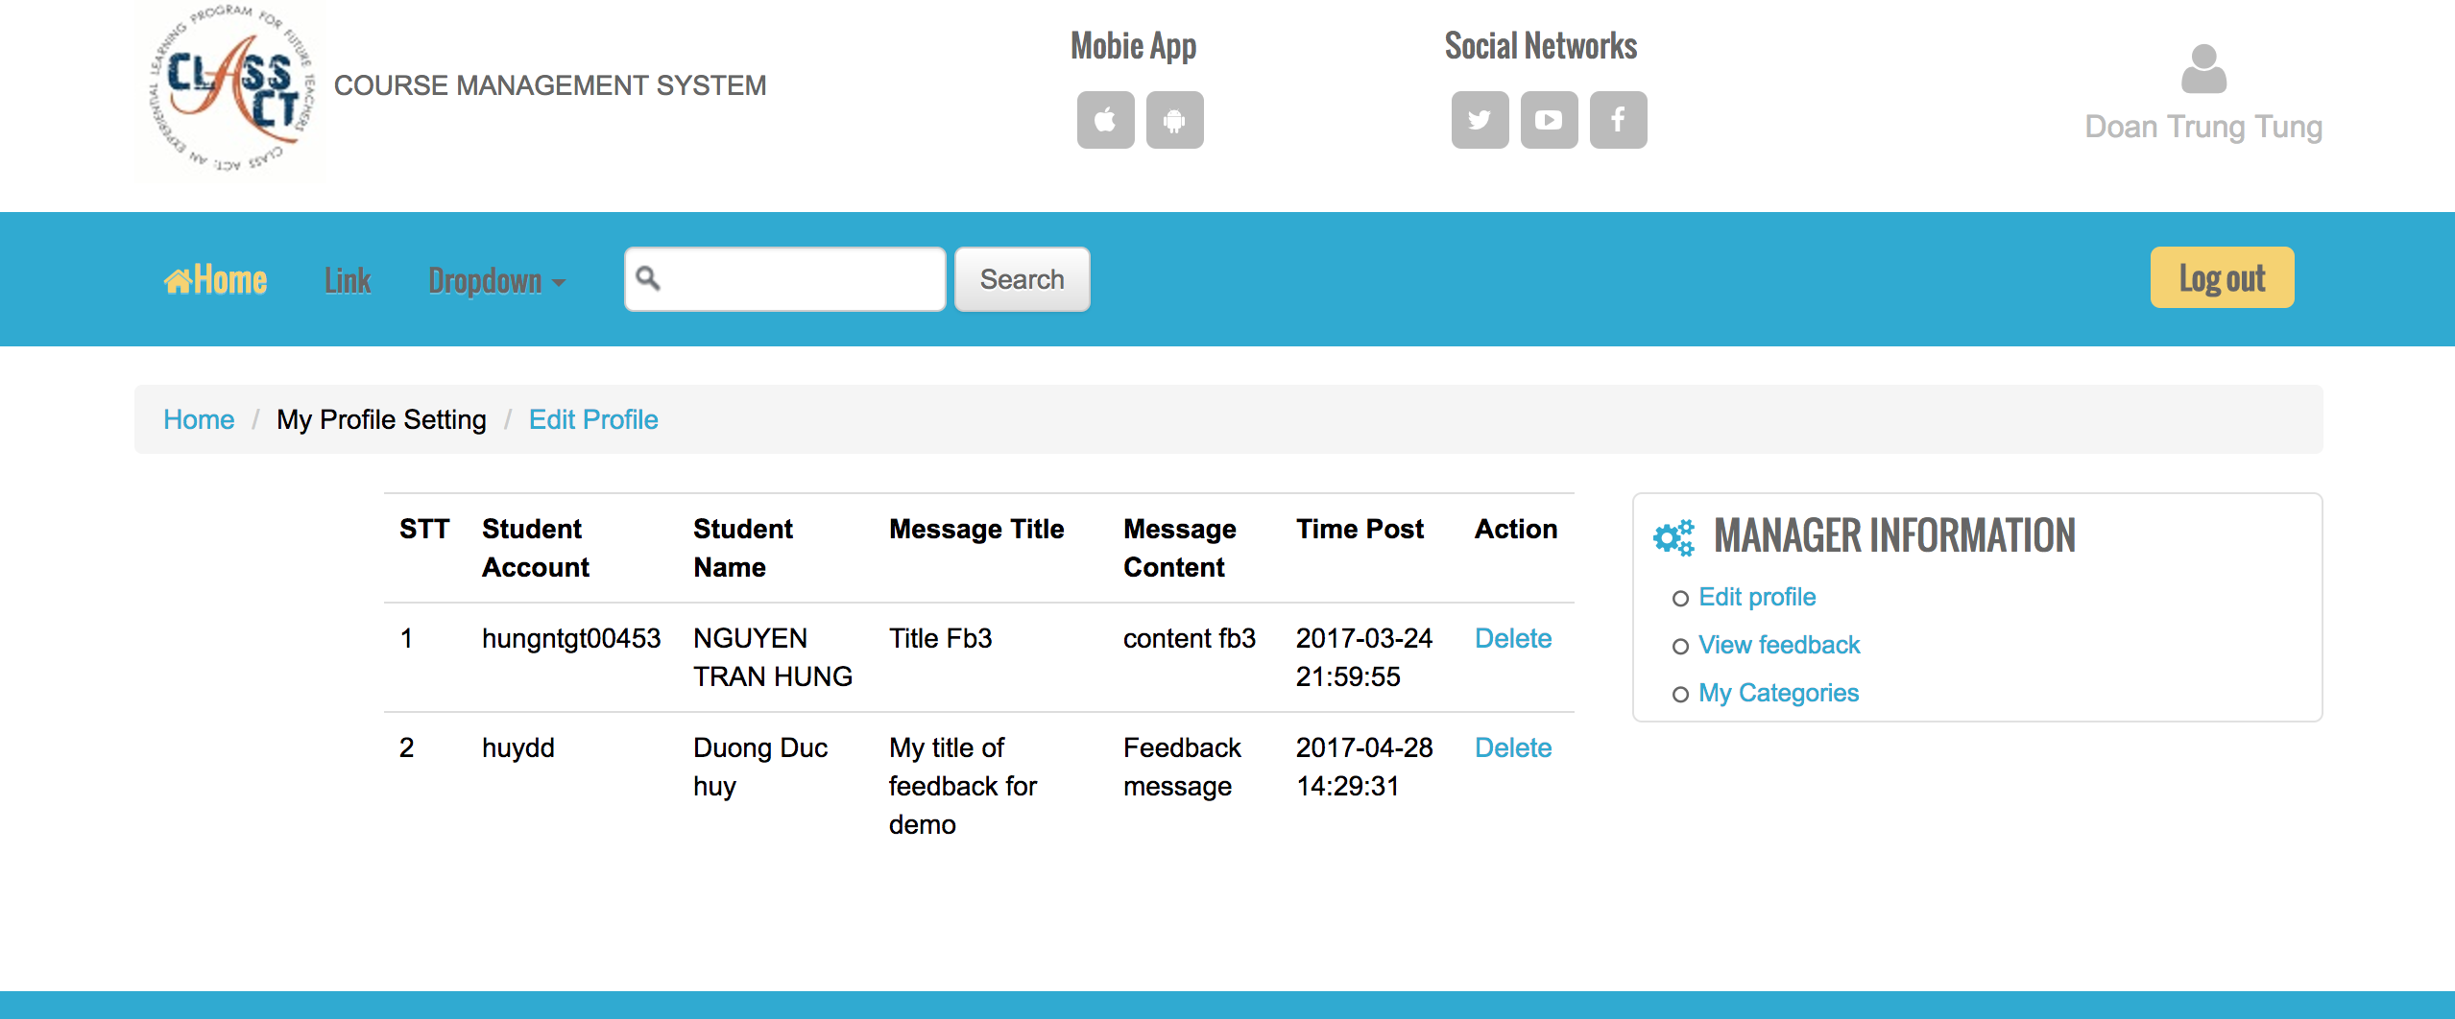
Functionality for each role in the website
As a Teacher
I can view all or delete the feedback that students sent to

Slide 37
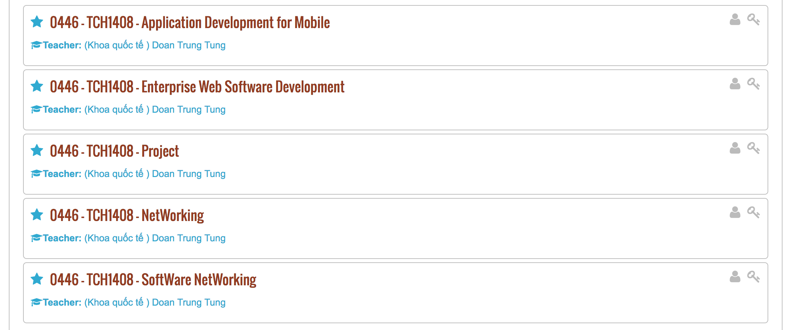
Functionality for each role in the website
As a teacher
I can view all the subjects that I am teaching

Slide 38
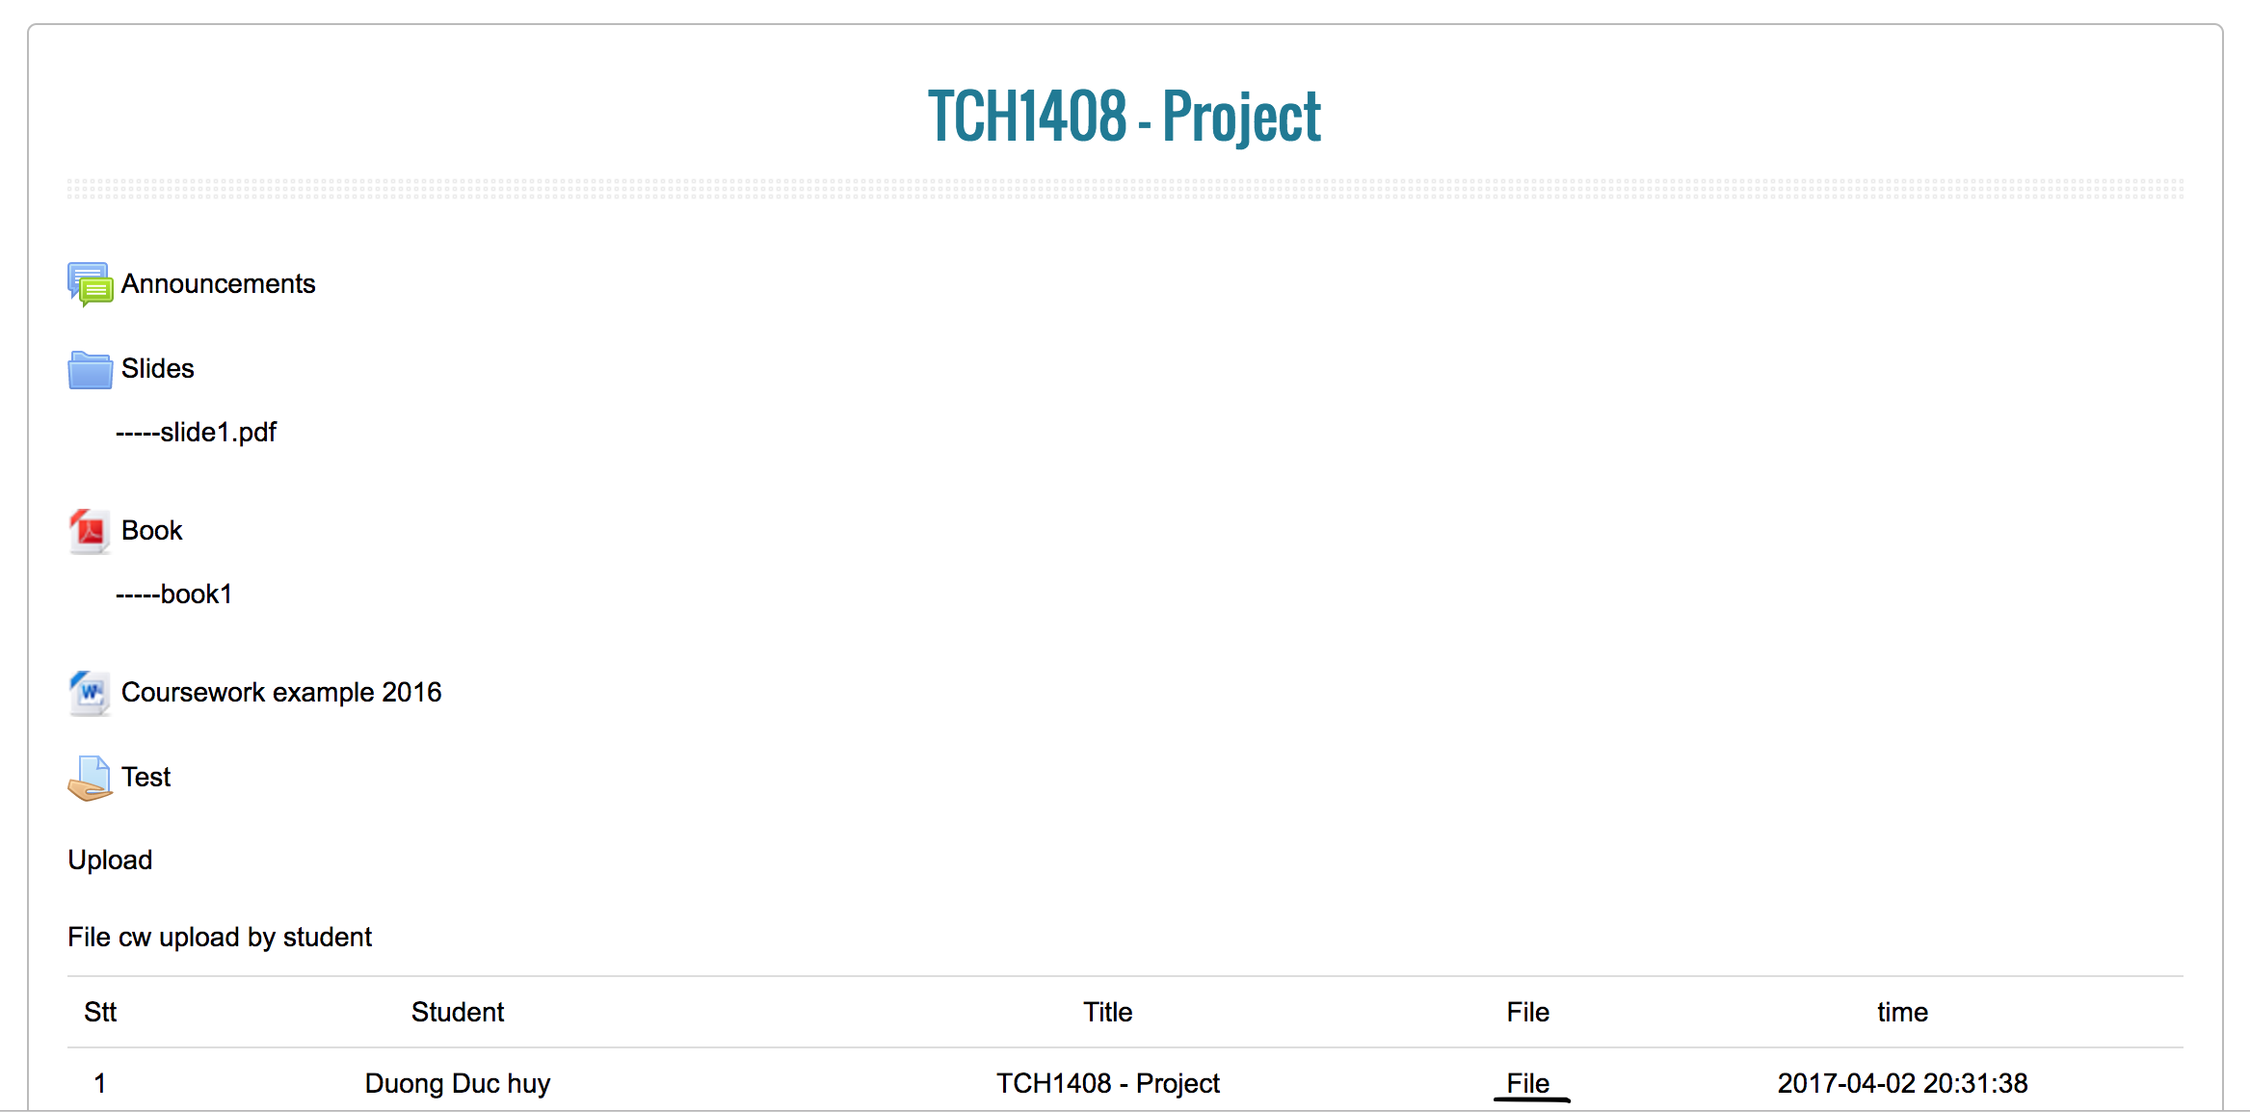
Functionality for each role in the website
As a Teacher
I can view all the document and the coursework that student uploaded by download it

Slide 39
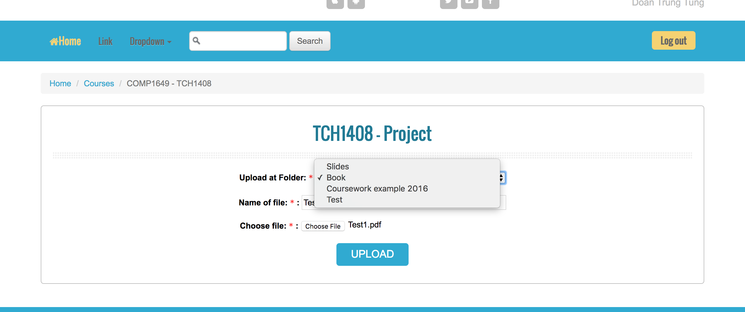
Functionality for each role in the website
As a Teacher
I can upload document for each Section: Book, Coursework Example and Test

Slide 40
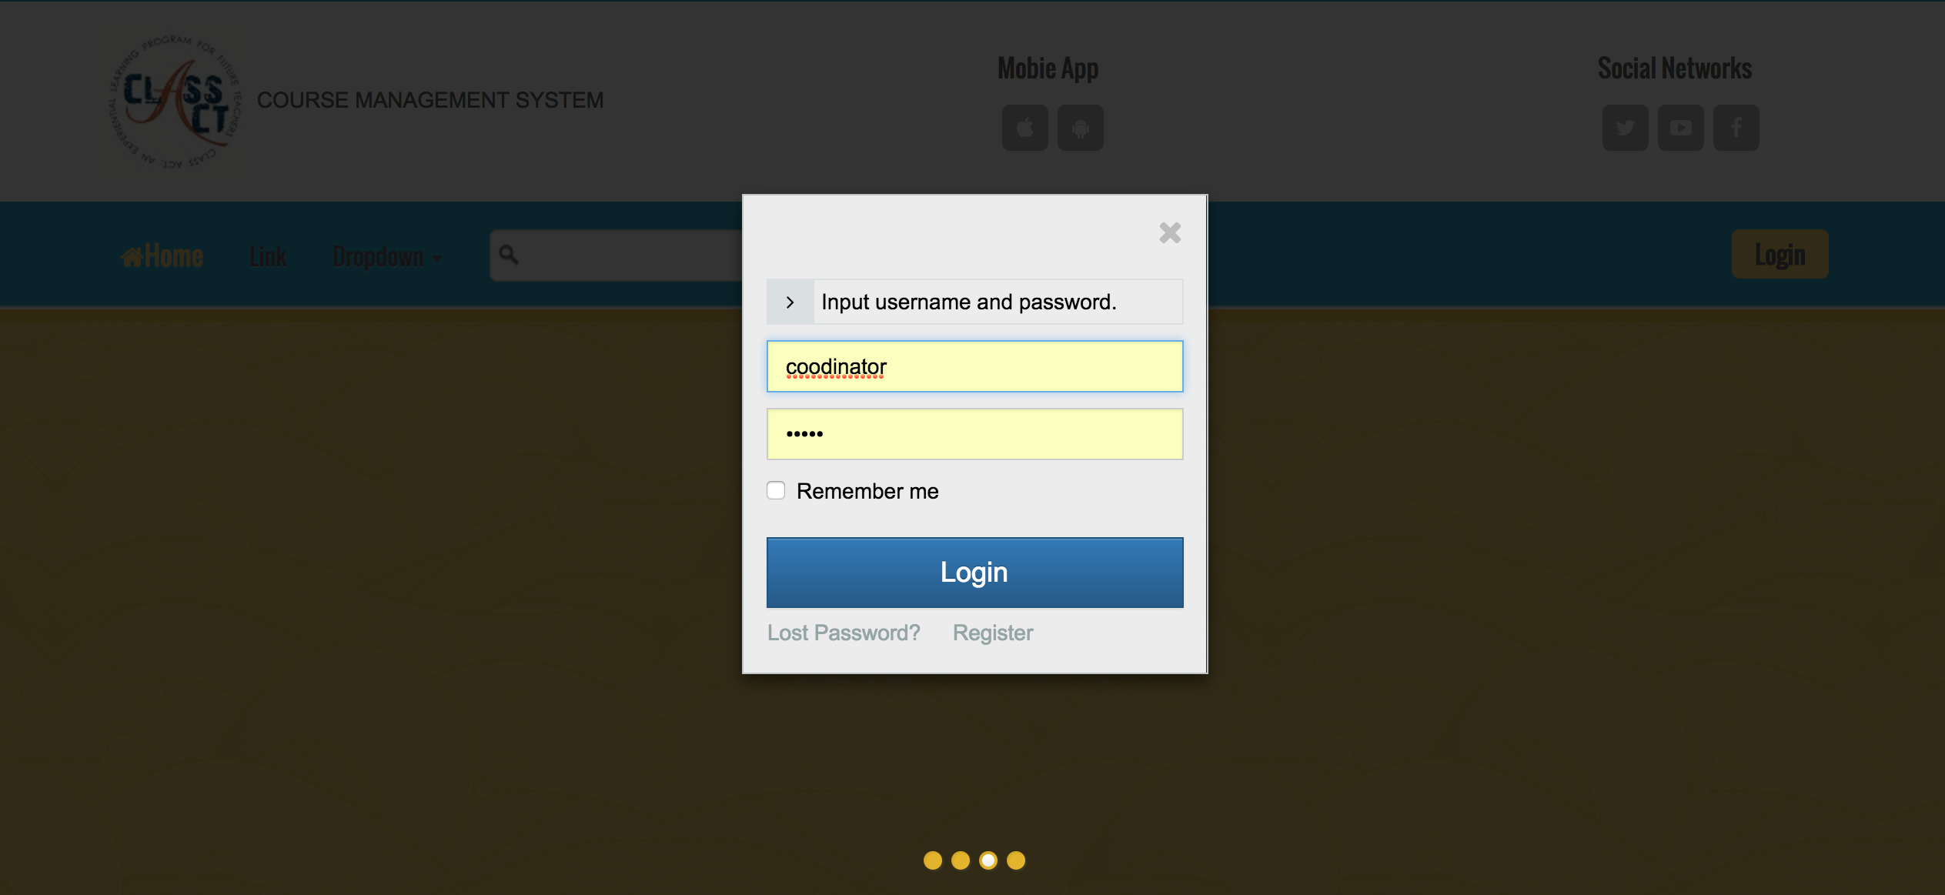
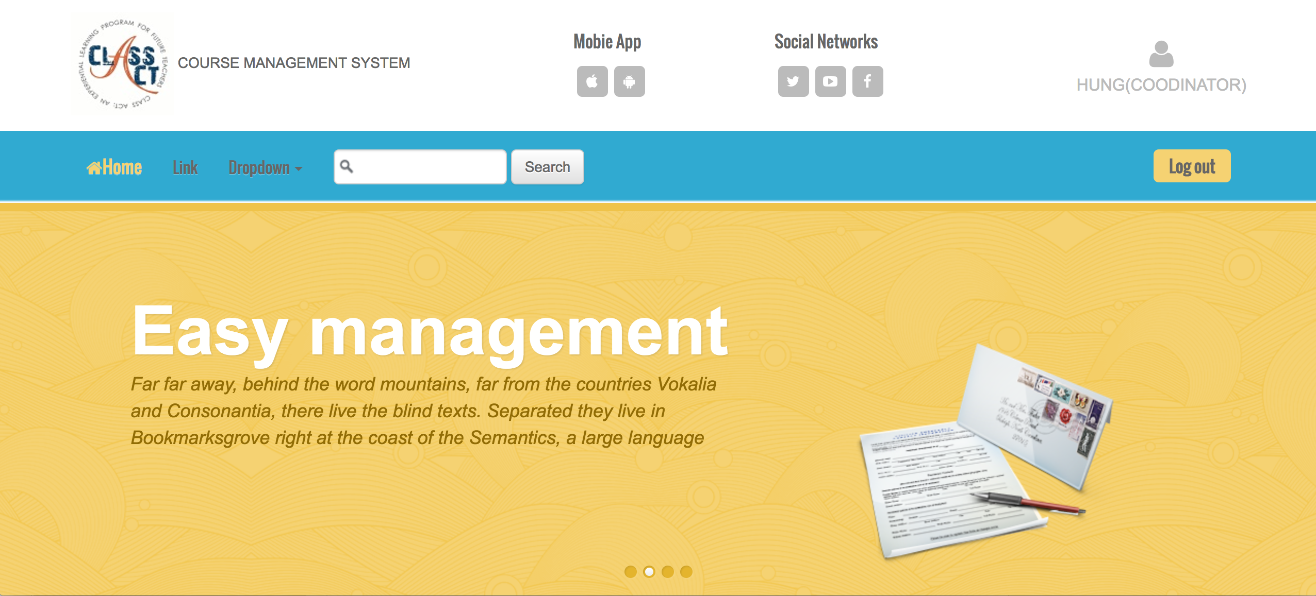
Functionality for each role in the website
As A Coordinator
I can login/logout to system

Slide 41
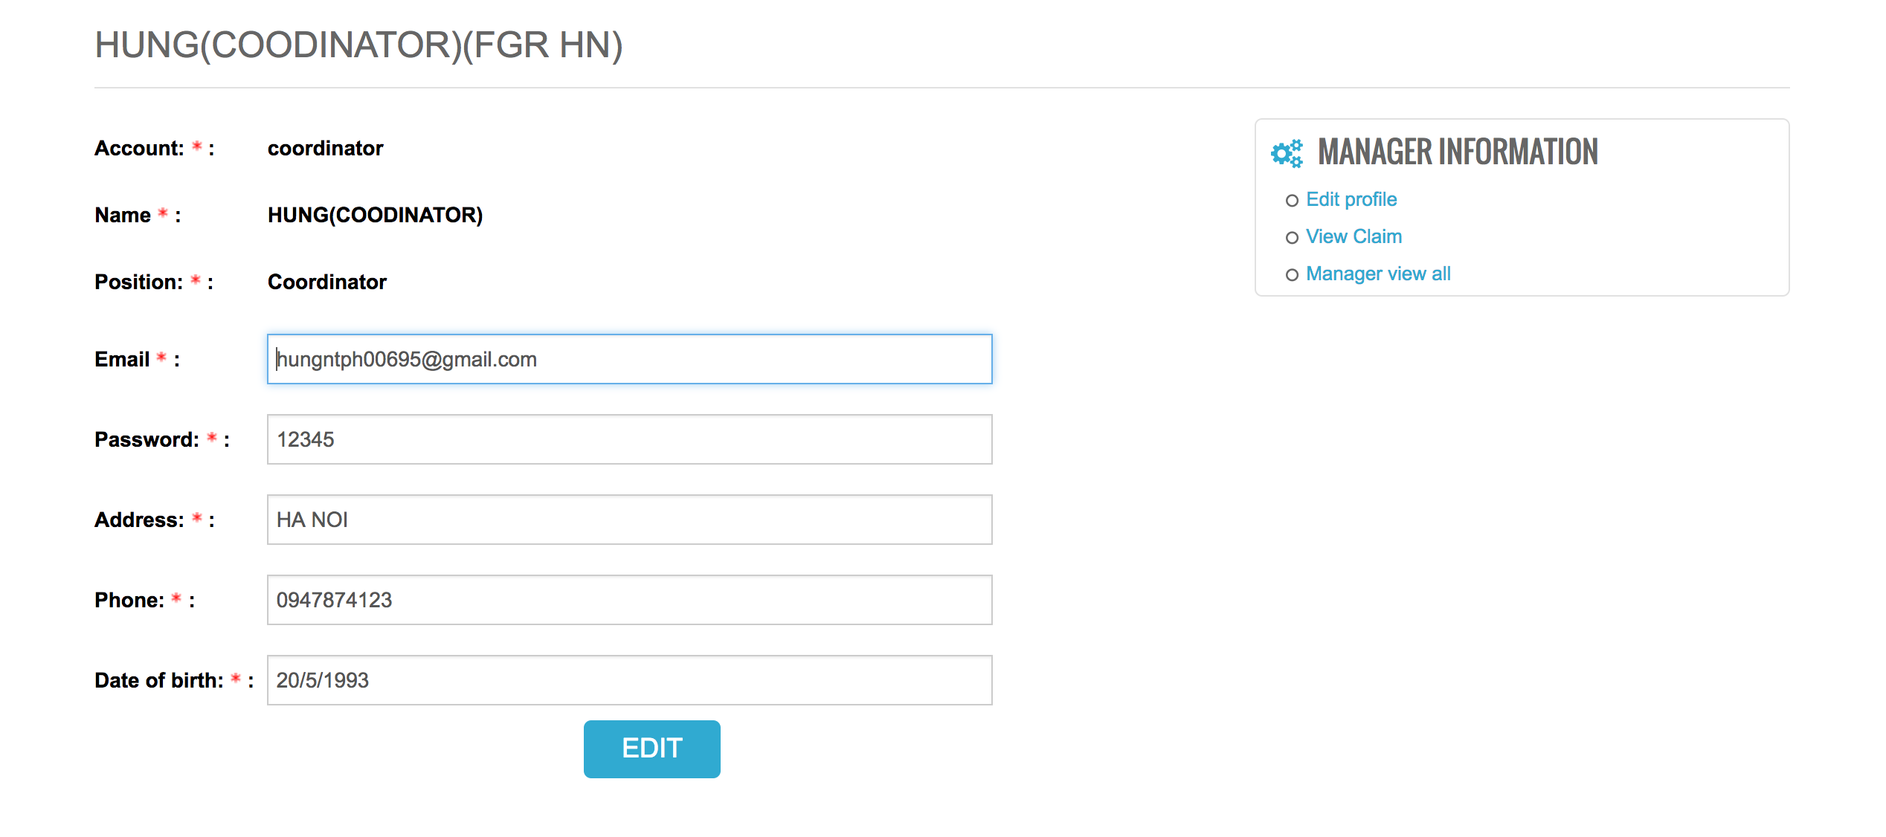
Functionality for each role in the website
As A Coordinator
I can edit the profile

Slide 42
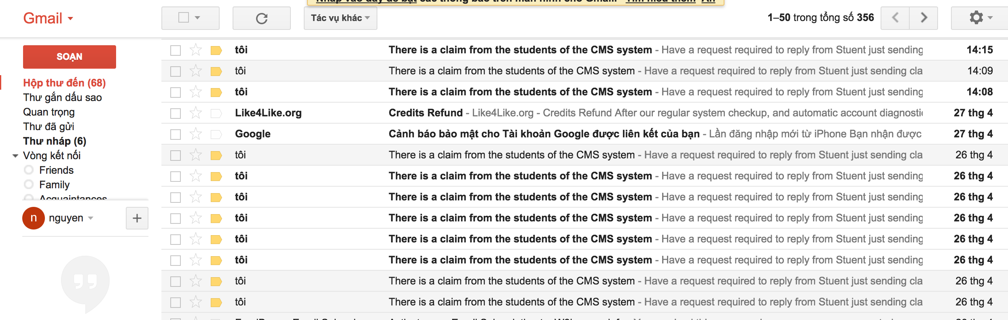
Functionality for each role in the website
As a Coordinator
Get notification from email when student just sent the claim

Slide 43
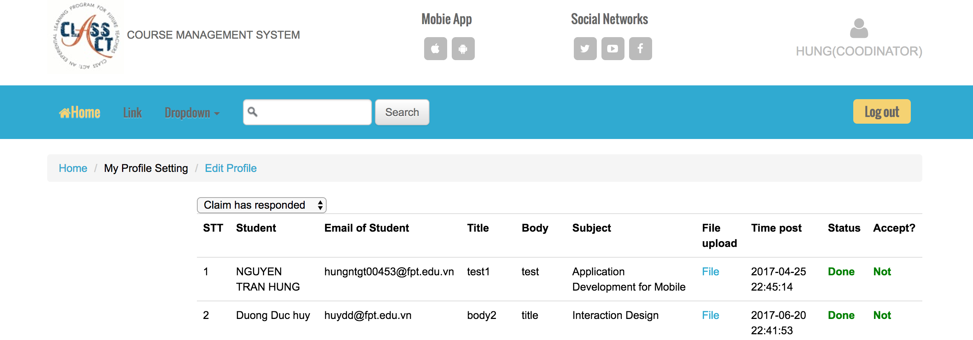
Functionality for each role in the website
As a Coordinator
I can view all the Claims has answered

Slide 44
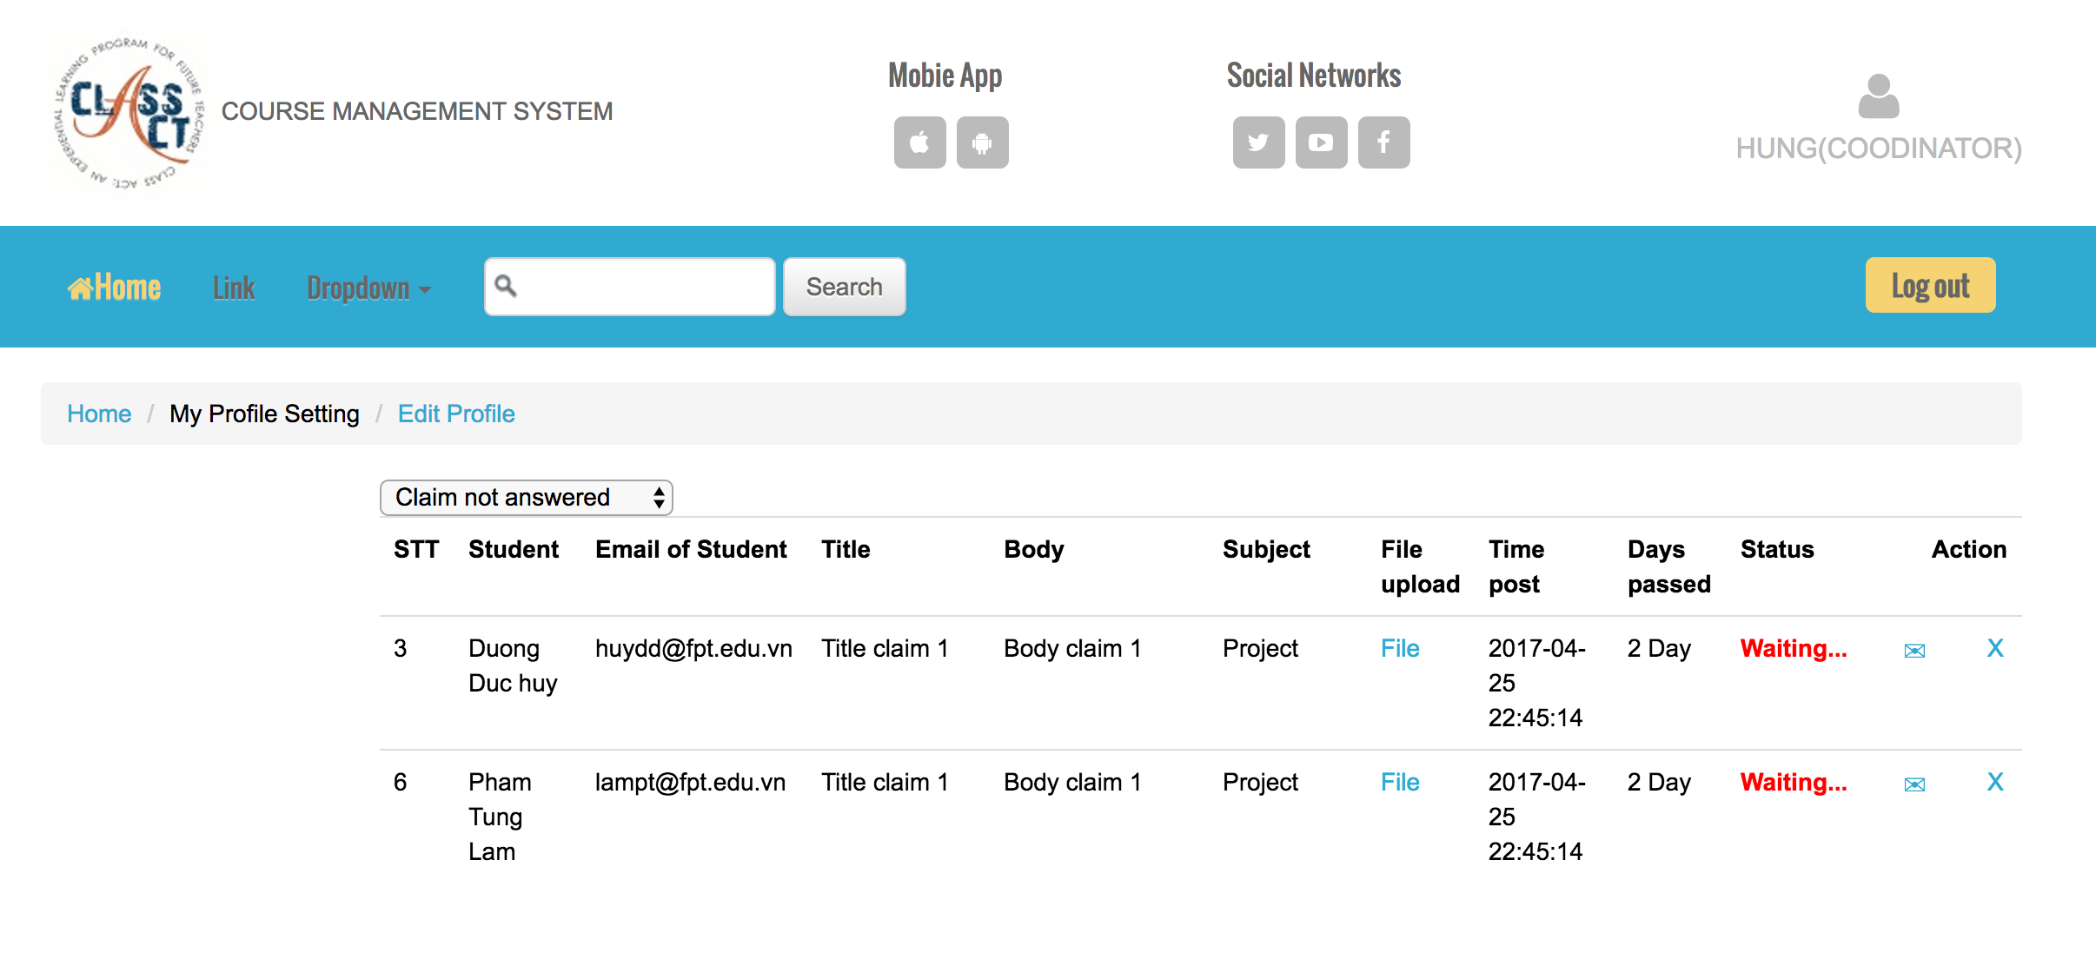
Functionality for each role in the website
As a Coordinator
I can view and handle the claims are not answered

Slide 45
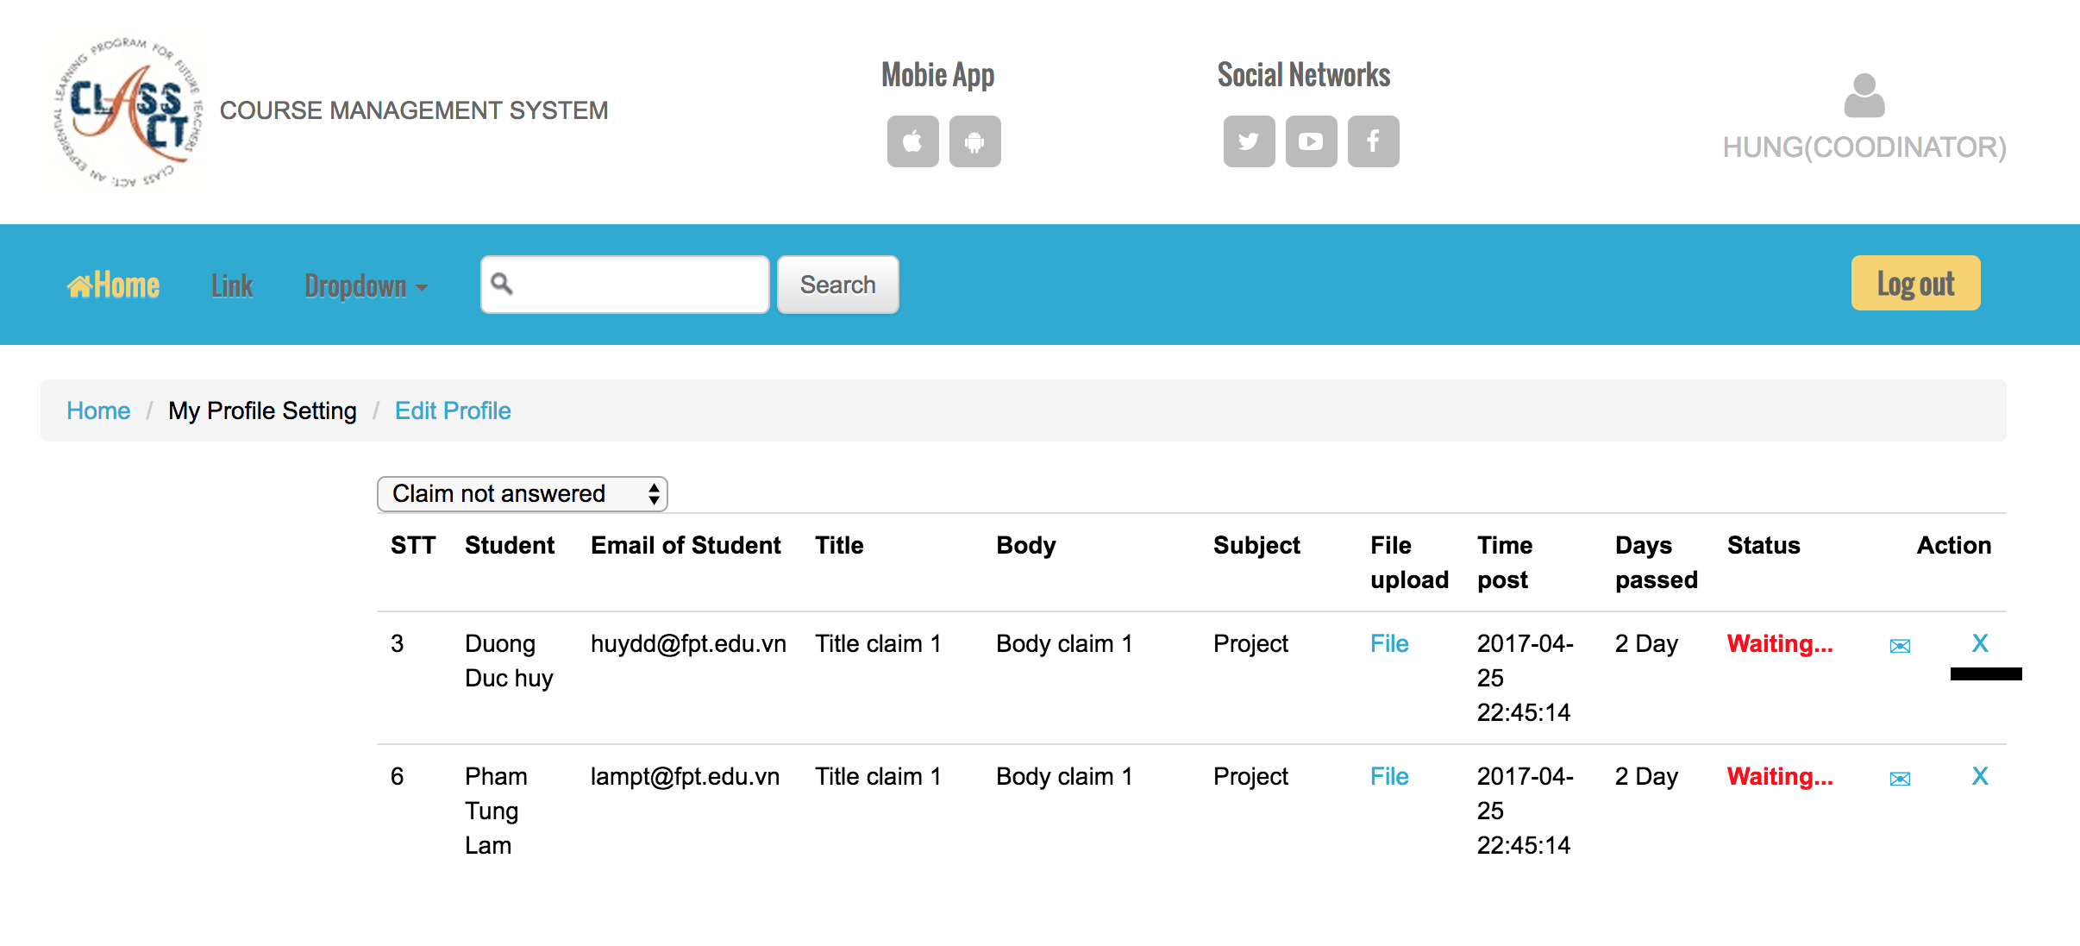
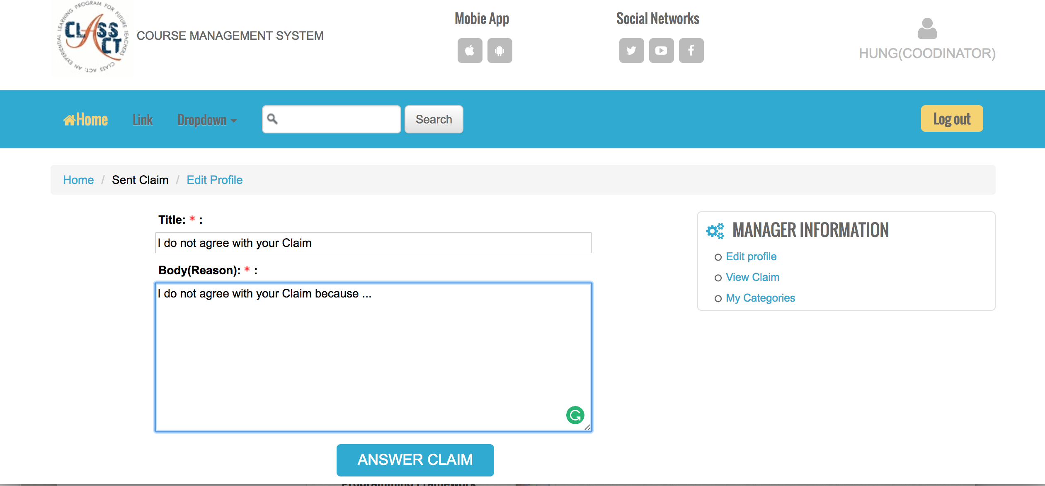
Functionality for each role in the website
As A Coordinator
I can reject the claim by click on X in Action column

Slide 46
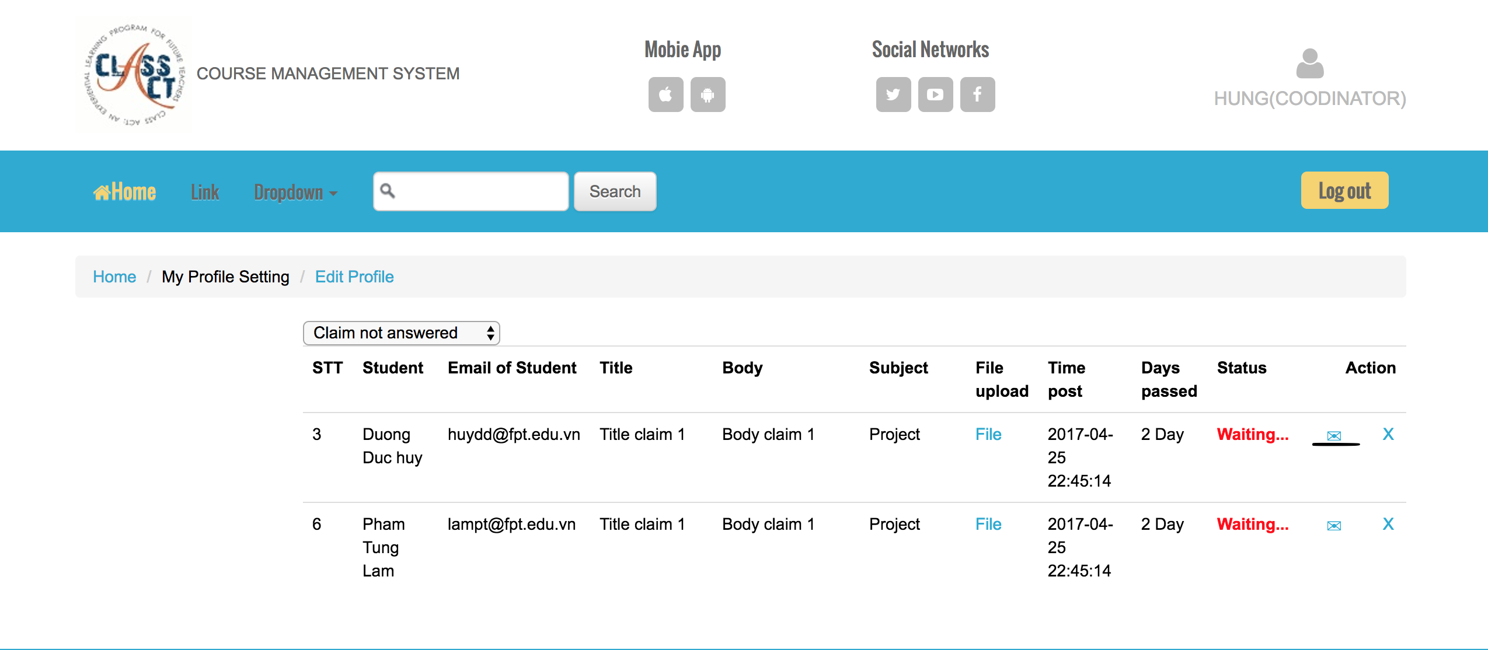
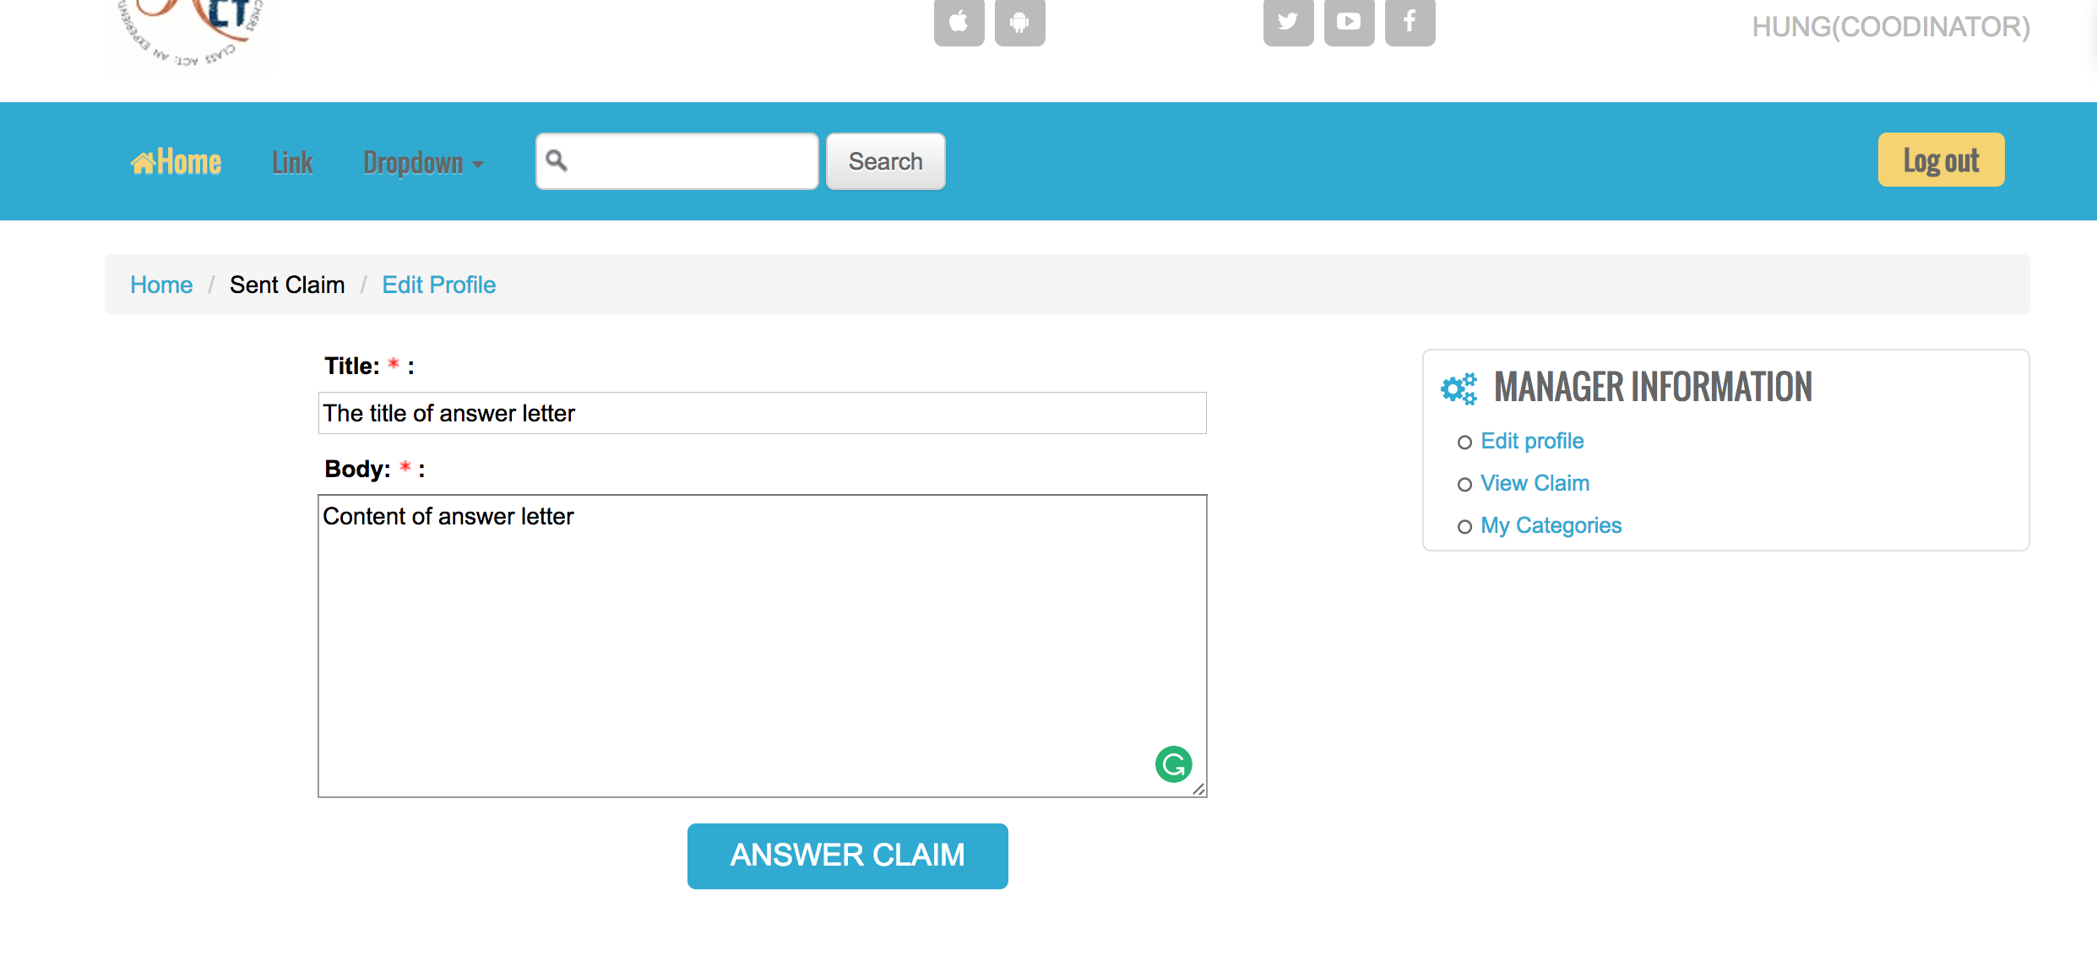
Functionality for each role in the website
As A Coordinator
I can answer the claim by click on Mail in Action column

Slide 47
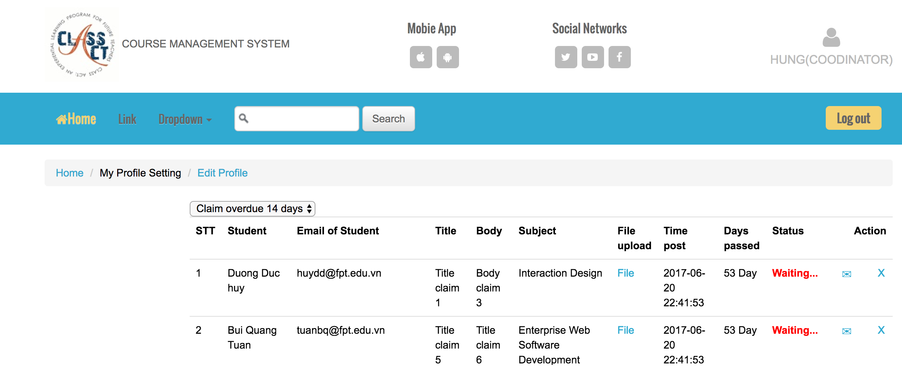
Functionality for each role in the website
As A Coordinator
I can view and handle the claim over 14 days

Slide 48
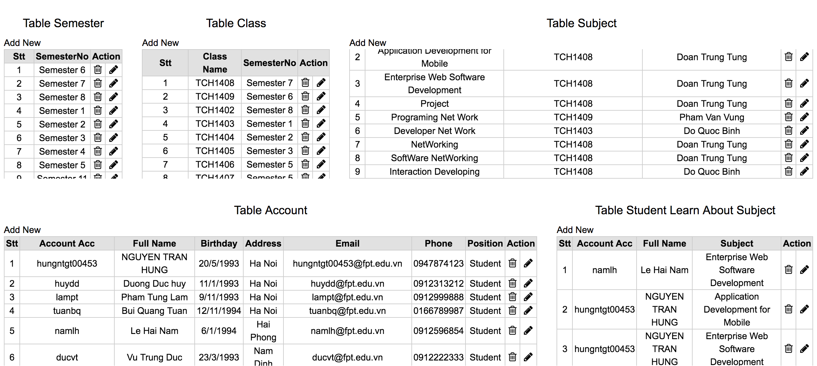
Functionality for each role in the website
As A Coordinator
I can Add / Update / Delete to manage Semester, Class, Subject, Account, Student learn in each Subject

Slide 49
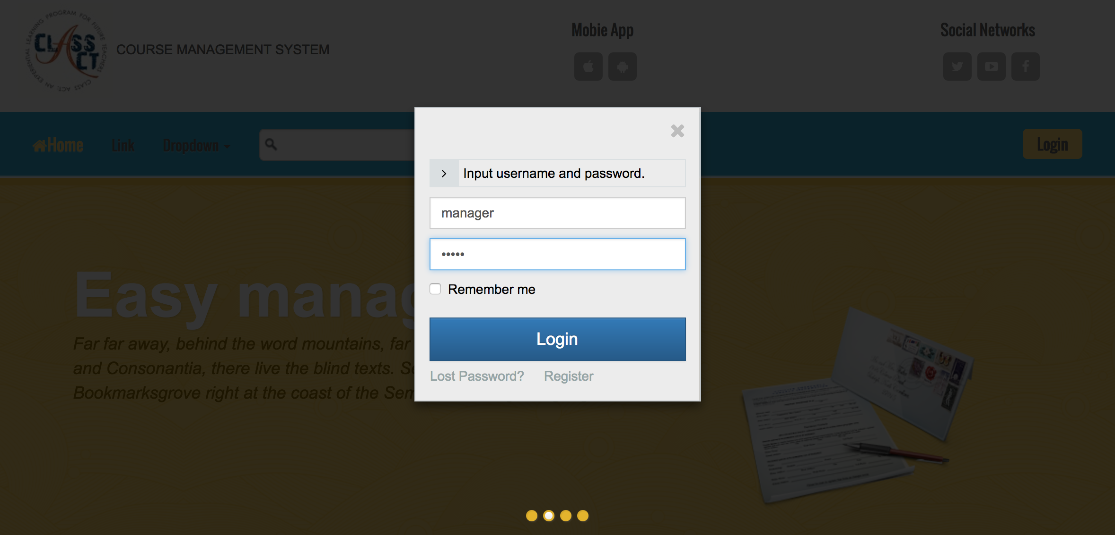
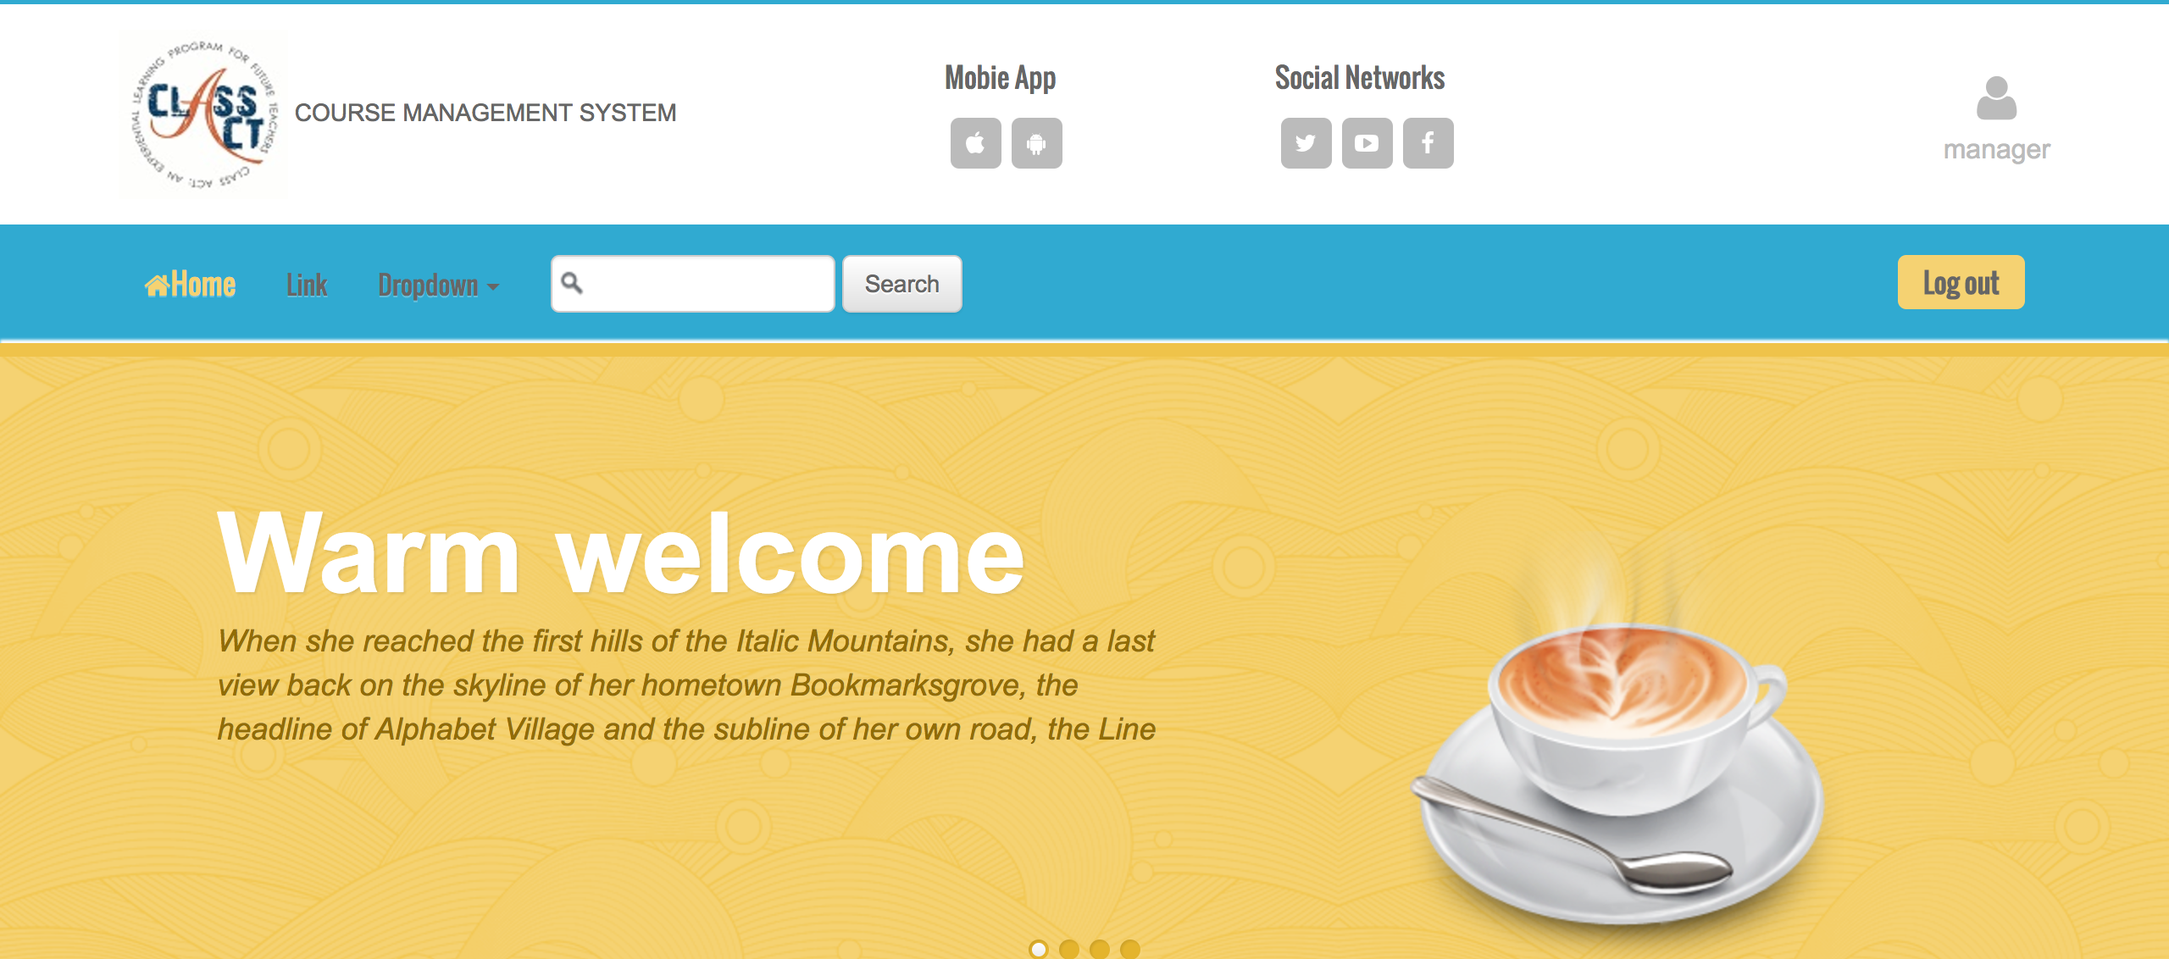
Functionality for each role in the website
As A Manager
I can login/logout to system

Slide 50
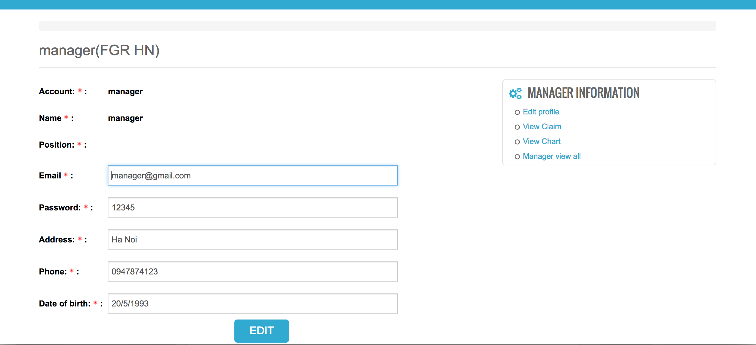
Functionality for each role in the website
As A Manager
I can edit the profile

Slide 51
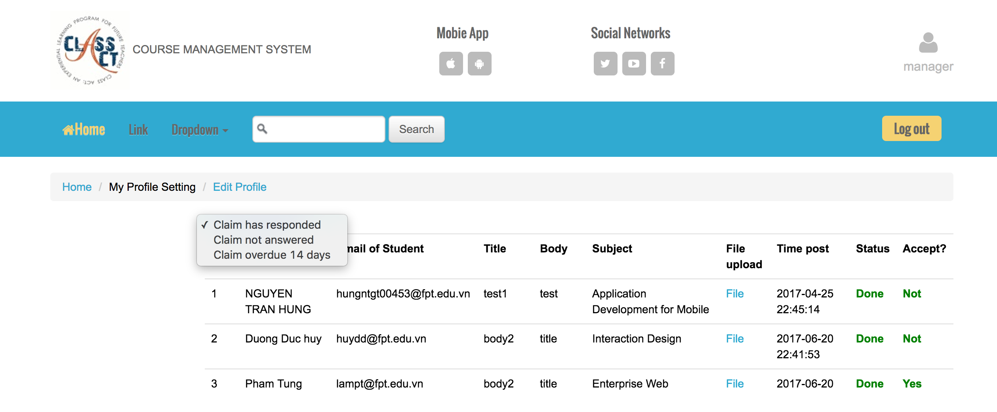
Functionality for each role in the website
As A Manager
I can view all the Claims has answered, not answered and over due 14 days but can not process

Slide 52

Functionality for each role in the website
View the chart of statics and comparison

Slide 53

Functionality for each role in the website
View the chart of statics and comparison

Slide 54

Functionality for each role in the website
As A Manager
I can view static of Claims without uploaded evidence and print to download it in PDF by click on PDF

Slide 55

Functionality for each role in the website
As A Manager
I can view static of Claims overdue 14 days and print to download it in PDF by click on PDF

Slide 56
testing
Test log of Functional and Non-functional testing

Slide 57

testing
TEST LOG ON NON-FUNCTIONAL

Slide 58

TESTING
TESTING ON NON-FUNCTIONAL

Slide 59

TESTING
TESTING ON NON-FUNCTIONAL

Slide 60

TESTING
TESTING ON NON-FUNCTIONAL

Slide 61

TESTING
TESTING ON NON-FUNCTIONAL

Slide 62

TESTING
TESTING ON FUNCTIONAL OF STUDENT

Slide 63

TESTING
TESTING ON FUNCTIONAL OF STUDENT

Slide 64

TESTING
TESTING ON FUNCTIONAL OF STUDENT

Slide 65

TESTING
TESTING ON FUNCTIONAL OF STUDENT

Slide 66

TESTING
TESTING ON FUNCTIONAL OF TEACHER

Slide 67

TESTING
TESTING ON FUNCTIONAL OF TEACHER

Slide 68

TESTING
TESTING ON FUNCTIONAL OF COORDINATOR

Slide 69

TESTING
TESTING ON FUNCTIONAL OF COORDINATOR

Slide 70


TESTING
TESTING ON FUNCTIONAL OF COORDINATOR

Slide 71
TESTING
TESTING ON FUNCTIONAL OF COORDINATOR

Slide 72
TESTING
TESTING ON FUNCTIONAL OF COORDINATOR

Slide 73
TESTING
TESTING ON FUNCTIONAL OF COORDINATOR

